Slide 1



Naan Mudhalvan
Industrial IoT and Industry 4.0
Tektork Private Limited, Coimbatore

Slide 2
Module II
Introduction to Sensor Technology
Tektork Private Limited, Coimbatore

Slide 3
Industrial IoT and Industry 4.0
Definition of Sensors and Transducers
Sensors
A sensor is a device that detects and measures physical phenomena in its environment and converts that information into an electrical signal.
Essentially, it acts as the "eyes and ears" of a system, providing data about the real world.
This data is then sent to a processor, which can be a computer or microcontroller, for analysis and decision-making.
Example: A temperature sensor (thermistor, thermocouple) converts temperature changes into resistance or voltage changes.
Tektork Private Limited, Coimbatore

Slide 4
Industrial IoT and Industry 4.0
Transducer
A transducer is any device that converts energy from one form to another. This conversion can be from electrical to non-electrical, or vice versa.
Transducers are used at the boundaries of systems to convert signals into a different form of energy.
All sensors are transducers, but not all transducers are sensors.
A microphone converts sound (acoustic energy) into an electrical signal.
A loudspeaker converts an electrical signal into sound.
Tektork Private Limited, Coimbatore

Slide 5
Industrial IoT and Industry 4.0
Sensor Vs Transducer
Aspect | Sensor | Transducer
Definition | A device that detects or measures a physical quantity and converts it into an electrical signal (or readable form). | A device that converts one form of energy into another (not limited to electrical signals).
Function | Sensing (detecting changes in the environment). | Energy conversion (input transducers = sensors, output transducers = actuators).
Scope | Narrow – specifically related to measurement of physical parameters. | Broader – includes sensors and actuators.
Output | Usually gives an electrical signal proportional to the physical quantity. | Can give electrical, mechanical, thermal, acoustic, or other forms of energy.
Examples | Thermistor (temperature sensor), LDR (light sensor), PIR sensor (motion). | Microphone (sound → electrical), Loudspeaker (electrical → sound), Piezoelectric crystal (mechanical → electrical).
Type | Always an input device. | Can be an input device (sensor) or an output device (actuator).
Application | Used for measurement and monitoring. | Used for both measurement and control/actuation.
Tektork Private Limited, Coimbatore

Slide 6
Industrial IoT and Industry 4.0
Importance of Sensors
Sensors are vital to modern technology and industry, playing a critical role in automation, safety, and efficiency. Their key importance includes:
Real-Time Data Collection
Sensors provide continuous, up-to-date data on system conditions, enabling rapid responses to changing situations and improving process control.
Improved Safety
Monitoring critical parameters helps detect and address hazards early, supports automatic shutdown systems, and reduces risks in dangerous environments.
Process Automation
By enabling machines to sense and respond to their environment, sensors automate industrial, building, and domestic processes, reducing manual labor and human error.
Tektork Private Limited, Coimbatore

Slide 7
Industrial IoT and Industry 4.0
Importance of Sensors Contd..
Higher Product Quality
With accurate feedback, sensors help maintain consistent product standards by detecting defects and enabling precise adjustments during manufacturing.
Efficiency and Cost Savings
Sensors help optimize energy use, reduce waste, improve maintenance schedules, and allow for predictive rather than reactive repairs, saving money across sectors.
Enabling Advanced Technologies
Sensors are foundational for the Internet of Things (IoT), robotics, smart buildings, and autonomous systems, supporting next-generation digital infrastructure.
Tektork Private Limited, Coimbatore

Slide 8
Industrial IoT and Industry 4.0
Importance of Sensors Contd..
Facilitating the Internet of Things (IoT)
Sensors are the foundational technology for the IoT.
They connect physical devices to the digital world, allowing for the creation of smart homes, smart cities, and industrial automation networks where devices can communicate and make intelligent decisions.
Tektork Private Limited, Coimbatore

Slide 9
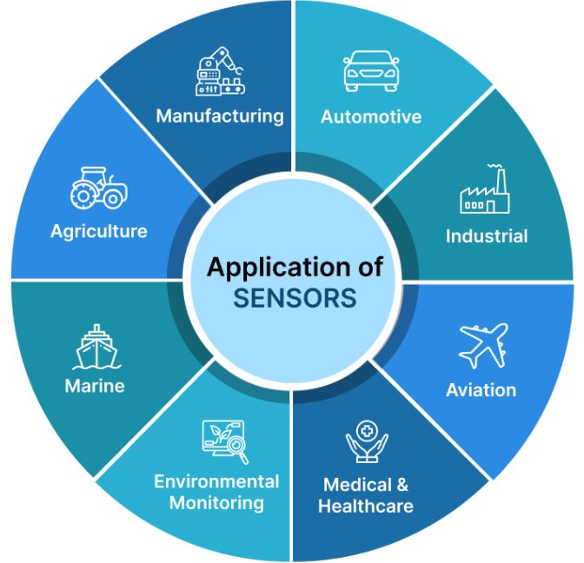
Industrial IoT and Industry 4.0
Applications of Sensors
Tektork Private Limited, Coimbatore

Slide 10
Industrial IoT and Industry 4.0
Applications of Sensors
Sensors have widespread use, including but not limited to:
Manufacturing/Industrial Automation
Monitoring temperature, pressure, humidity, pH, vibration, and flow to automate and optimize production lines and ensure safety.
Pressure sensors: Monitor hydraulic systems and fluid dynamics.
Vibration sensors: Detect machinery faults before breakdowns.
Proximity and position sensors: Guide robotic arms and conveyor systems.
Flow sensors: Control chemical and liquid processes.
Tektork Private Limited, Coimbatore

Slide 11
Industrial IoT and Industry 4.0
Applications of Sensors
Smart Buildings
Controlling lighting, HVAC, and security with occupancy, temperature, and motion sensors for energy savings and comfort.
Motion sensors: Automate lighting, security systems, and energy-saving features.
Temperature sensors: Regulate HVAC systems for comfort and efficiency.
Smoke and gas detectors: Alert occupants to fire or leaks.
Light sensors: Adjust indoor lighting based on ambient conditions.
Tektork Private Limited, Coimbatore

Slide 12
Industrial IoT and Industry 4.0
Applications of Sensors
Consumer Electronics
Found in smartphones (gyroscope, accelerometer), wearables (heart rate, step counting), and home appliances (touch and temperature sensors).
Accelerometers and gyroscopes: Enable screen rotation, gaming, and fitness tracking.
Touch sensors: Power smartphones, tablets, and smartwatches.
Biometric sensors: Enable fingerprint and facial recognition.
Ambient light sensors: Adjust screen brightness automatically.
Tektork Private Limited, Coimbatore

Slide 13
Industrial IoT and Industry 4.0
Applications of Sensors Cond…
Healthcare
Biosensors for glucose monitoring, vital sign sensors for ICUs, and diagnostic medical instruments.
Heart rate and ECG sensors: Monitor vital signs in wearables and hospital equipment.
Temperature sensors: Track patient health and manage incubators.
Glucose sensors: Help diabetics manage blood sugar levels.
Imaging sensors: Power X-rays, MRIs, and ultrasound machines.
Tektork Private Limited, Coimbatore

Slide 14
Industrial IoT and Industry 4.0
Applications of Sensors Cond…
Automotive and Transportation
Crash detection, lane guidance, tire pressure monitoring, and self-driving vehicle navigation.
Parking sensors: Help drivers avoid obstacles.
Speed and acceleration sensors: Enable ABS and traction control.
Oxygen sensors: Optimize fuel combustion and reduce emissions.
Rain sensors: Automatically activate windshield wipers.
Tektork Private Limited, Coimbatore

Slide 15
Industrial IoT and Industry 4.0
Applications of Sensors Cond…
Environmental Monitoring
Checking air and water quality, radiation, pollution, and weather stations in cities and the natural environment.
Air quality sensors: Detect pollutants and allergens.
Water quality sensors: Monitor contamination in rivers and reservoirs.
UV sensors: Measure solar radiation for health and energy applications.
Seismic sensors: Detect earthquakes and structural vibrations.
Tektork Private Limited, Coimbatore

Slide 16
Industrial IoT and Industry 4.0
Applications of Sensors Cond…
Agriculture and Farming
Checking Soil moisture and water quality, Ph Level, and weather stations in agriculture and forming.
Soil moisture sensors: Optimize irrigation and conserve water.
pH sensors: Monitor soil health for better crop yields.
Weather sensors: Predict rainfall, temperature, and wind for farm planning.
Livestock monitoring sensors: Track animal health and movement.
Tektork Private Limited, Coimbatore

Slide 17
Industrial IoT and Industry 4.0
Applications of Sensors Cond…
Safety and Security
Fire alarms, gas leak detection, motion-triggered security cameras, and intrusion sensors.
Motion Sensors: Detect unauthorized movement in restricted areas or during specific hours.
Door/Window Contact Sensors: Alert when doors or windows are opened unexpectedly.
Glass Break Sensors: Recognize the sound frequency of breaking glass to trigger alarms.
Smoke & Gas Detectors: Warn occupants of fire, carbon monoxide, or gas leaks.
Tektork Private Limited, Coimbatore

Slide 18
Industrial IoT and Industry 4.0
Applications of Sensors Cond…
Surveillance Cameras with PIR Sensors: Activate recording only when motion is detected, saving storage and energy.
Flame & Heat Sensors: Detect fire hazards in factories and chemical plants.
Vibration Sensors: Monitor machinery for early signs of malfunction or structural instability.
Proximity Sensors: Prevent accidents by stopping machines when a person or object is too close.
Leak Detection Sensors: Identify chemical, gas, or water leaks in pipelines and storage tanks.
Tektork Private Limited, Coimbatore

Slide 19
Industrial IoT and Industry 4.0
Applications of Sensors Cond…
Collision Sensors: Trigger airbags and emergency braking systems.
Blind Spot Sensors: Alert drivers to nearby vehicles outside their field of view.
Tire Pressure Sensors: Prevent blowouts and improve fuel efficiency.
Driver Fatigue Sensors: Monitor eye movement or steering patterns to detect drowsiness.
Surveillance Sensors: Integrated with AI to detect suspicious behavior in public areas.
Environmental Sensors: Monitor air quality, radiation, or toxic gases in urban zones.
Tektork Private Limited, Coimbatore

Slide 20
Industrial IoT and Industry 4.0
Applications of Sensors Cond…
Emergency Call Buttons with Location Sensors: Help citizens report incidents with precise location tracking.
Gunshot Detection Sensors: Used in high-risk areas to alert law enforcement instantly.
Fence Breach Sensors: Alert farmers to intrusions or escaped livestock.
Weather Sensors: Warn of extreme conditions that could endanger crops or workers.
Pesticide Level Sensors: Ensure safe application and prevent overexposure.
Tektork Private Limited, Coimbatore

Slide 21
Industrial IoT and Industry 4.0
Applications of Sensors Cond…
Biometric Sensors: Fingerprint, iris, and facial recognition for secure access.
RFID/NFC Sensors: Control entry to secure zones using smart cards or mobile devices.
Tamper Sensors: Detect unauthorized access or physical interference with devices.
Tektork Private Limited, Coimbatore

Slide 22
Industrial IoT and Industry 4.0
Applications of Sensors Cond…
Aerospace/Space Exploration
Navigation sensors for satellites, spacecraft performance, and atmospheric measurement.
Altitude and pressure sensors: Guide aircraft navigation.
Infrared sensors: Enable night vision and heat detection.
Radar and sonar sensors: Assist in surveillance and mapping.
Gyroscopic sensors: Stabilize drones and spacecraft.
Tektork Private Limited, Coimbatore

Slide 23
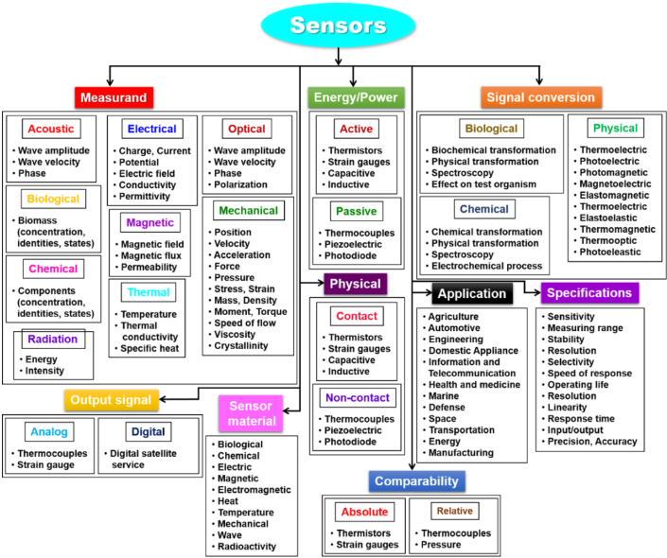
Industrial IoT and Industry 4.0
Classification of Sensors
Tektork Private Limited, Coimbatore

Slide 24
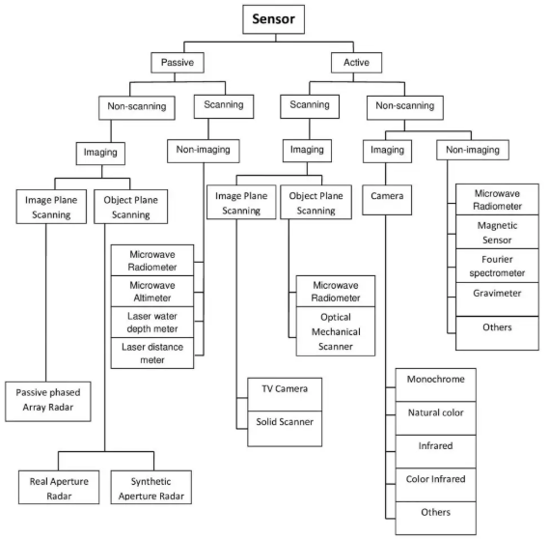
Industrial IoT and Industry 4.0
Tektork Private Limited, Coimbatore

Slide 25
Industrial IoT and Industry 4.0
Passive sensor:
It does not need any additional energy source and directly generates an electric signal in response to an external stimulus.
That is, the input stimulus energy is converted by the sensor into the output signal. Most of passive sensors are direct sensors as we defined them earlier.
Example: a thermocouple, a photodiode, and a piezoelectric sensor.
Active Sensor
It requires external power for its operation, which is called an excitation signal.
That signal is modified by the sensor to produce the output signal.
Example: a thermistor is a temperature sensitive resistor.
It does not generate any electric signal, but by passing an electric current through it (excitation signal) its resistance can be measured by detecting variations in current and/or voltage across the thermistor.
Tektork Private Limited, Coimbatore

Slide 26
Industrial IoT and Industry 4.0
Classification based on Measurement
Sensors can be classified based on different criteria such as measurement , working principle, output type, and power requirement.
Temperature Sensors
Measure the degree of hotness or coldness. Examples include thermocouples, thermistors, and resistance temperature detectors (RTDs).
Pressure Sensors
Measure pressure, typically of gases or liquids. These are used in a variety of applications, from barometric pressure measurement to tire pressure monitoring.
Tektork Private Limited, Coimbatore

Slide 27
Industrial IoT and Industry 4.0
Classification based on Measurement
Proximity Sensors
Detect the presence of an object without physical contact. Examples include capacitive, inductive, and infrared (IR) sensors.
Force and Weight Sensors
Measure the force, stress, or weight applied to them. Load cells are a prime example, often used in digital scales.
Motion and Position Sensors
Measure movement, speed, or location. These include accelerometers, gyroscopes, and linear variable differential transformers (LVDTs).
Tektork Private Limited, Coimbatore

Slide 28
Industrial IoT and Industry 4.0
Classification based on Measurement
Chemical and Gas Sensors
Detect the presence and concentration of specific chemical compounds or gases.
Examples include pH sensors and smoke detectors.
Bio-sensors
Use a biological component (like an enzyme or antibody) to detect specific biological substances, commonly used in medical diagnostics.
Tektork Private Limited, Coimbatore

Slide 29
Industrial IoT and Industry 4.0
Classification based on Working Principle
Resistive
The sensor's electrical resistance changes in proportion to the physical quantity being measured. Examples: Thermistors (temperature) and strain gauges (force).
Capacitive
The sensor's capacitance changes due to a change in the physical quantity. These are often used for measuring position, displacement, and fluid levels.
Piezoelectric
These sensors generate a voltage when mechanical stress or pressure is applied. They are commonly used in accelerometers and microphones.
Tektork Private Limited, Coimbatore

Slide 30
Industrial IoT and Industry 4.0
Classification based on Working Principle
Inductive
The sensor operates on the principle of electromagnetic induction, where changes in a magnetic field or inductance are used for detection.
Inductive proximity sensors for metal detection and LVDTs for displacement are good examples.
Hall Effect
These sensors produce a voltage output when a magnetic field is applied perpendicular to a current-carrying conductor.
They are used for magnetic field detection, position sensing, and current sensing.
Tektork Private Limited, Coimbatore

Slide 31
Industrial IoT and Industry 4.0
Classification based on Working Principle
Optical
The sensor's operation is based on light and its properties. This can involve measuring light intensity, wavelength, or changes in a light beam.
Photodiodes and IR sensors fall into this category.
Thermoelectric
These sensors convert a temperature difference into an electrical voltage.
Thermocouples are a classic example of this principle.
Tektork Private Limited, Coimbatore

Slide 32
Industrial IoT and Industry 4.0
Temperature sensors
Temperature sensors are devices designed to measure the amount of heat or cold (temperature) in objects, environments, or processes and provide readings in readable units such as Celsius or Fahrenheit.
They are widely used in electronics, industry, IoT, automotive, HVAC, and biomedical applications.
Tektork Private Limited, Coimbatore

Slide 33
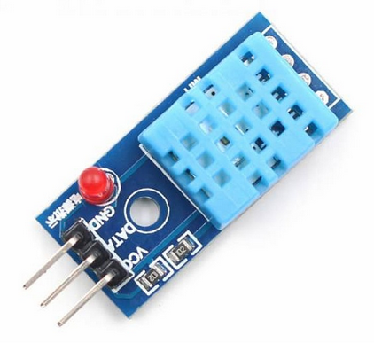
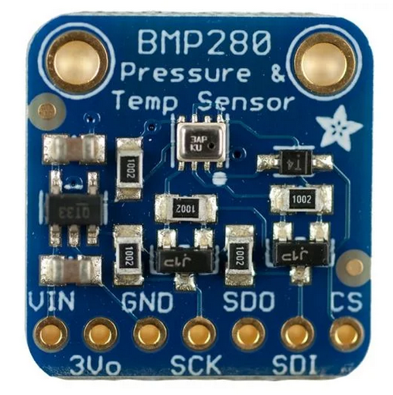
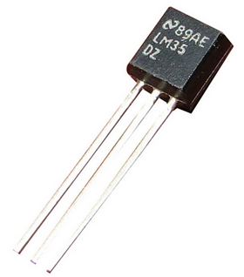
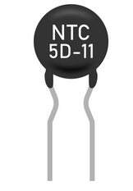
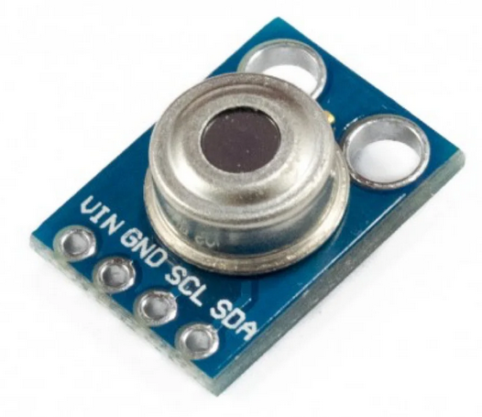
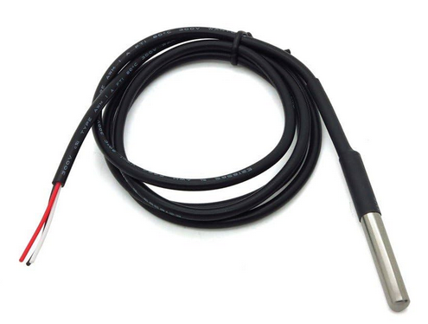
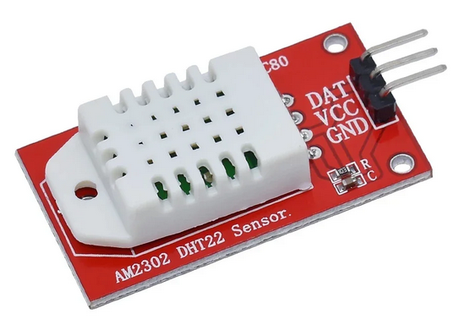
Industrial IoT and Industry 4.0
Temperature sensors
DHT 11
BMP280
LM35
Thermistor
DHT 22
MLX90614
DS18B20
Tektork Private Limited, Coimbatore

Slide 34
Industrial IoT and Industry 4.0
Working Principle
Most temperature sensors work by converting thermal changes (heat/coolness) into a corresponding change in electrical properties like resistance, voltage, or current.
For example, the resistance across a thermistor or RTD changes with temperature, while thermocouples generate a voltage proportional to temperature differences (Seebeck effect).
Tektork Private Limited, Coimbatore

Slide 35
Industrial IoT and Industry 4.0
Main Types of Temperature Sensors
Contact Sensors
These must be in direct contact with the target. Common examples are:
Thermocouples:
Two different metals joined at one end, producing a voltage related to temperature differences. Wide temperature range, generally low accuracy, nonlinear output.
Made of two different metals joined at one end.
Generate a voltage based on the temperature difference (Seebeck effect).
Range: –200 °C to +1750 °C (depending on type: J, K, T, etc.)
Advantages: Wide range, rugged, inexpensive.
Disadvantages: Requires reference junction compensation, less accurate than RTDs.
Tektork Private Limited, Coimbatore

Slide 36
Industrial IoT and Industry 4.0
Resistance Temperature Detectors (RTD):
Metal resistors (often platinum) whose resistance varies linearly with temperature. Highly accurate and stable, used in critical applications.
Resistance of metal (usually platinum, like PT100/ PT1000) changes with temperature.
Range: –200 °C to +850 °C
Advantages: Very accurate, stable over time.
Disadvantages: More expensive, slower response.
Tektork Private Limited, Coimbatore

Slide 37
Industrial IoT and Industry 4.0
Thermistors:
Typically made from semiconductor material; resistance decreases as temperature rises. NTC (Negative Temperature Coefficient) thermistors are common in consumer electronics and medical devices.
Semiconductor resistors whose resistance changes non-linearly with temperature.
Two types: NTC (Negative Temperature Coefficient) and PTC (Positive Temperature Coefficient).
Range: –100 °C to +300 °C (NTC).
Advantages: High sensitivity, inexpensive.
Disadvantages: Limited range, non-linear.
Tektork Private Limited, Coimbatore

Slide 38
Industrial IoT and Industry 4.0
Non-Contact Sensors:
These measure temperature by detecting infrared (thermal) radiation.
Infrared Thermometers/Pyrometers/Thermal Imaging Cameras: Used when contact is unsafe or impractical (hazardous fields, moving objects).
Non-contact measurement using infrared radiation.
Examples: MLX90614, FLIR sensors.
Range: –70 °C to +380 °C (depends on model).
Advantages: Can measure without touching, useful for moving/hazardous objects.
Disadvantages: Sensitive to dust, smoke, and emissivity variations.
Tektork Private Limited, Coimbatore

Slide 39
Industrial IoT and Industry 4.0
Other Types and Special Features
Semiconductor-Based Sensors:
Incorporated on IC chips, use matched diode junctions; linear output but less accurate, narrower range, and slower response.
Glass Thermometers and Fiber Bragg Gratings: Occasionally used in specialized applications
Use built-in diodes or transistors to measure temperature.
Available as analog (LM35, TMP36) or digital (DS18B20, TMP102, DHT11/DHT22 for temp+humidity).
Range: –55 °C to +150 °C.
Advantages: Easy to interface with microcontrollers, calibrated, compact.
Disadvantages: Limited range, not as rugged as thermocouples.
Tektork Private Limited, Coimbatore

Slide 40
Industrial IoT and Industry 4.0
Common Temperature Sensors in Electronics/IoT
LM35, LM75, TMP36 → Simple analog sensors.
DS18B20 → Digital, 1-Wire protocol, waterproof versions available.
DHT11 / DHT22 → Combined temperature + humidity sensor.
BMP280 / BME280 → Temperature, pressure, (and humidity in BME280).
MLX90614 → IR-based, non-contact.
Tektork Private Limited, Coimbatore

Slide 41
Industrial IoT and Industry 4.0
Applications
Industrial automation (process control)
Environmental monitoring
Consumer electronics (appliances, cars)
Medical diagnostics and life sciences
Building and structural monitoring (bridges, dams)
Safety systems (fire detection)
Tektork Private Limited, Coimbatore

Slide 42
Industrial IoT and Industry 4.0
Comparative Table
Type | Range (°C) | Accuracy | Responsiveness | Output | Notable Uses
Thermocouple | -200 to 1750 | 0.5–5°C | Fast | Nonlinear | Industrial, high heat
RTD | -200 to 600 | High | Moderate | Linear | Scientific, industrial
NTC Thermistor | -50 to 250 | High | Very fast | Nonlinear | Electronics, HVAC, medical
Semiconductor | -70 to 150 | Moderate | Slow | Linear | Embedded systems, IoT
IR/Pyrometer | Varies | Varies | Fast | Non-contact | Hazardous, remote sensing
Tektork Private Limited, Coimbatore

Slide 43
Industrial IoT and Industry 4.0
Pressure sensors
Pressure sensors are devices that measure the force exerted by a gas or liquid on a surface and convert this mechanical pressure into an electrical signal for monitoring or control purposes.
They are widely used in industrial automation, automotive systems, environmental monitoring, and safety applications.
Tektork Private Limited, Coimbatore

Slide 44
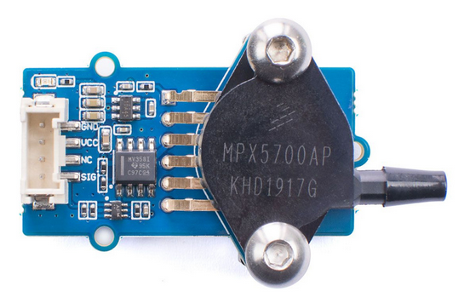
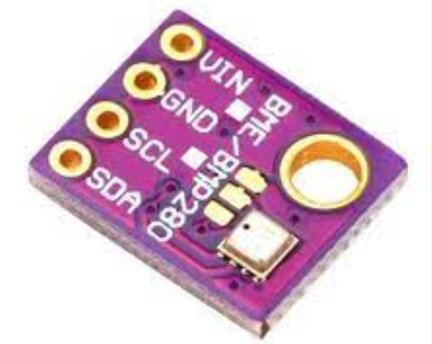
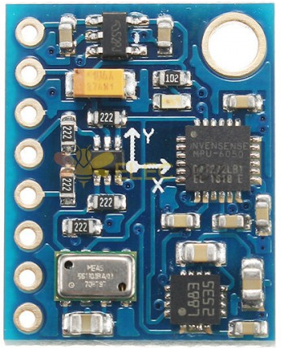
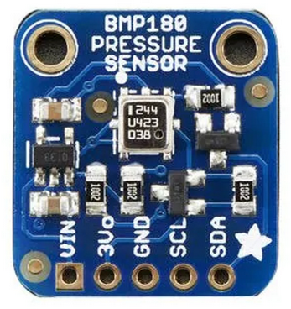
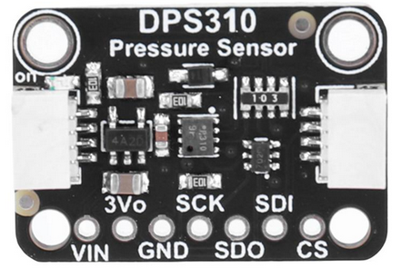
Industrial IoT and Industry 4.0
Pressure sensors
BMP280
MPX5700
MS5611
BMP180
DPS310
Tektork Private Limited, Coimbatore

Slide 45
Industrial IoT and Industry 4.0
Working Principle
A typical pressure sensor includes a sensing element (such as a diaphragm) which deflects when pressure is applied; the amount of deflection is proportional to the pressure's magnitude.
This mechanical deformation is then converted into an electrical signal through different technologies, such as:
Strain gauge (piezoresistive): Resistance changes as the diaphragm stretches, measured in volts.
Capacitive: The diaphragm forms part of a capacitor, and changes in capacitance are detected as the diaphragm moves.
Piezoelectric: Certain crystals generate a voltage when subjected to mechanical stress.
Others: Inductive, optical, and resonant types are used in specific applications.
Tektork Private Limited, Coimbatore

Slide 46
Industrial IoT and Industry 4.0
Types of Pressure Sensors
Piezoresistive/Strain Gauge
These are the most common type. They use strain gauges whose electrical resistance changes when they are deformed by pressure on a diaphragm.
They are robust and accurate, making them suitable for a wide range of industrial and automotive applications.
Based on Wheatstone bridge with strain gauges.
Pressure deforms a diaphragm → resistance changes → voltage output.
Applications: Automotive (engine pressure, tire monitoring), industrial systems.
Tektork Private Limited, Coimbatore

Slide 47
Industrial IoT and Industry 4.0
Capacitive
These sensors measure pressure by detecting changes in electrical capacitance.
They consist of two plates, one of which is a flexible diaphragm.
As pressure flexes the diaphragm, the distance between the plates changes, which alters the capacitance.
They are known for high sensitivity, making them suitable for low-pressure applications.
High sensitivity, good for low-pressure ranges.
Applications: Medical devices, HVAC, barometers.
Tektork Private Limited, Coimbatore

Slide 48
Industrial IoT and Industry 4.0
Piezoelectric
These sensors use materials (like quartz) that generate a small electrical charge when subjected to mechanical stress.
This makes them ideal for measuring rapid, dynamic pressure changes, such as those in engine combustion.
They cannot measure static pressure because the charge dissipates over time.
Use piezoelectric crystals → generate charge when pressure is applied.
Very fast response but not suitable for static measurements (only dynamic).
Applications: Microphones, accelerometers, engine combustion monitoring.
Tektork Private Limited, Coimbatore

Slide 49
Industrial IoT and Industry 4.0
Resonant and Optical Pressure Sensors
Specialized applications such as meteorology or high-temperature environments.
Resonant Pressure Sensors
Pressure changes natural frequency of a vibrating element.
Very accurate and stable.
Applications: Aerospace, precision instruments.
Optical Pressure Sensors
Use light modulation (fiber optic or interferometry).
Immune to EMI, works in harsh environments.
Applications: Oil & gas, biomedical (catheters), aerospace.
Tektork Private Limited, Coimbatore

Slide 50
Industrial IoT and Industry 4.0
Common Pressure Sensors in Electronics/IoT
BMP180 / BMP280 / BME280 → Barometric pressure + temperature (and humidity in BME280).
MPX5700, MPX4115A → Automotive pressure sensors.
MS5611 → High-resolution barometric pressure for drones.
DPS310 → Ultra-compact digital pressure sensor.
Tektork Private Limited, Coimbatore

Slide 51
Industrial IoT and Industry 4.0
Applications
Industrial process control (e.g., hydraulic systems)
Automotive (e.g., tire pressure monitoring, engine boosting)
Medical devices (e.g., blood pressure monitors)
Environmental monitoring (weather stations)
Safety and alarm systems
Tektork Private Limited, Coimbatore

Slide 52
Industrial IoT and Industry 4.0
Proximity Sensors
Proximity sensors are contactless devices that detect the presence or movement of objects within a certain range and convert this information into an electrical signal.
They are widely used in automation, safety, mobile devices, IoT and process monitoring where non-contact object detection is critical.
Tektork Private Limited, Coimbatore

Slide 53
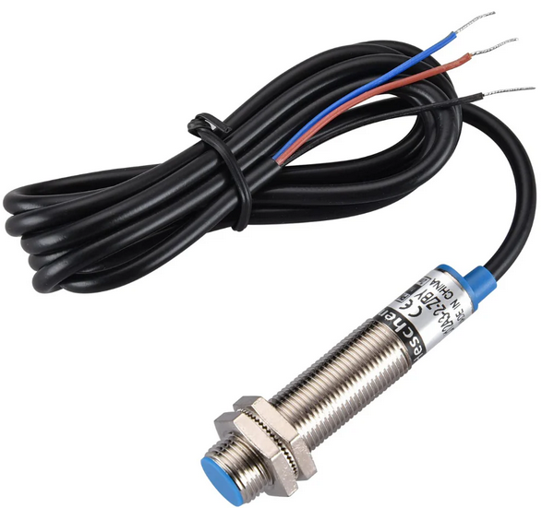
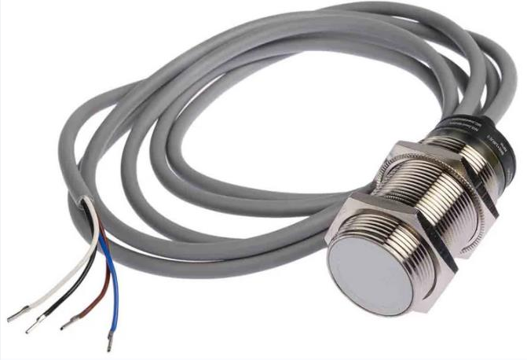
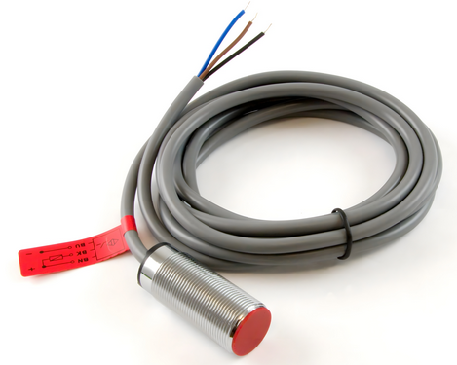
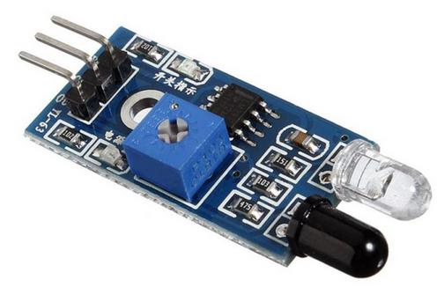
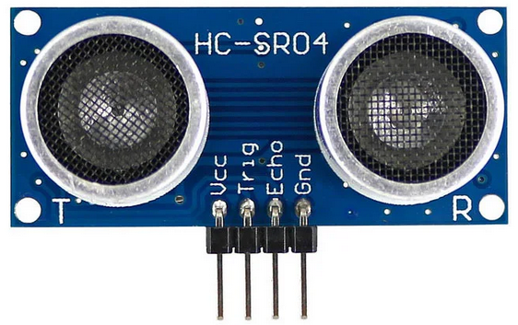
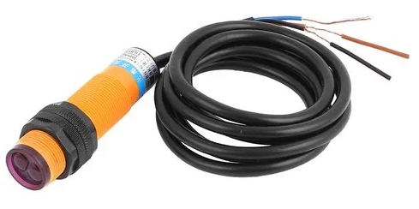
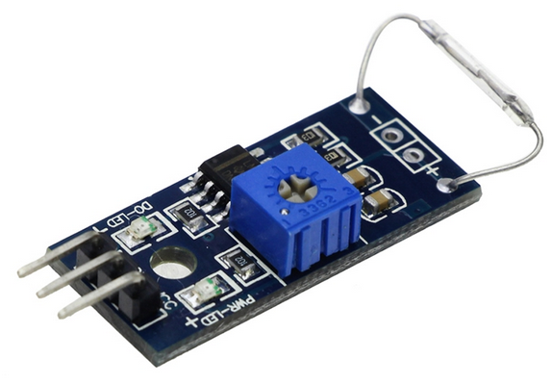
Industrial IoT and Industry 4.0
Inductive Proximity
Capacitive Proximity
Magnetic Proximity
IR Sensor Module
Optical Proximity
Magnetic Reed Switch
Ultranic Sensor
Tektork Private Limited, Coimbatore

Slide 54
Industrial IoT and Industry 4.0
Working Principle
All proximity sensors operate by sensing changes in some physical property (such as capacitance or magnetic field) when an object approaches the sensor's detection range, outputting a signal when the threshold is crossed.
Their operation is independent of the object's color, relying only on its movement, material, or other physical characteristics.
Tektork Private Limited, Coimbatore

Slide 55
Industrial IoT and Industry 4.0
Types of Proximity Sensors
Inductive Proximity Sensors
These sensors are used to detect metal objects. They create a magnetic field that is emitted from the sensor face.
When a metal object enters this field, it causes a change in the field's oscillation, which is detected by the sensor.
Metal entering the field induces eddy currents that alter the sensor's output.
Range: typically up to 10 mm.
Applications: Metal detection in automation, machine tools, conveyor systems, position detection,Counting parts.
Tektork Private Limited, Coimbatore

Slide 56
Industrial IoT and Industry 4.0
Capacitive Proximity Sensors
Sense both metallic and non-metallic objects (including solids, liquids, powders, plastic, glass,wood) by detecting changes in capacitance between the sensor and the target.
They work by generating an electrostatic field. When an object enters this field, it changes the capacitance between the sensor and its surroundings.
Capacitive sensors are useful for tasks like detecting the level of liquid in a tank or the presence of a box on a conveyor belt.
Range: up to ~25 mm.
Applications: Level detection (liquids, powders), packaging machines.
Tektork Private Limited, Coimbatore

Slide 57
Industrial IoT and Industry 4.0
Magnetic Proximity Sensors
Rely on magnetic fields, typically using Hall effect sensing or reed switches to detect magnetic objects like permanent magnets.
Hall Effect sensors give digital or analog output based on field strength.
Applications: Door sensors, speed sensing, smartphones, brushless motors.
Tektork Private Limited, Coimbatore

Slide 58
Industrial IoT and Industry 4.0
Optical Proximity Sensors
Detect objects by using a light emitter and receiver; measure reflected light from the target to identify its presence.
Types
Through-Beam: The emitter and receiver are in separate housings, and the object is detected when it breaks the light beam.
Retro-Reflective: The emitter and receiver are in the same housing, and the object is detected when it interrupts the beam that is bouncing off a special reflector.
Diffuse-Reflective: The emitter and receiver are in the same housing, and the object is detected when it reflects a portion of the emitted light back to the sensor.
Applications: Counting objects, safety barriers, smartphones (screen off during calls).
Tektork Private Limited, Coimbatore

Slide 59
Industrial IoT and Industry 4.0
Ultrasonic Proximity Sensors
These sensors use sound waves to detect objects.
The sensor emits a high-frequency sound pulse (ultrasound) and measures the time it takes for the echo to return.
By calculating the time of flight, the sensor determines the distance to the object. Can detect solid, liquid, or granular materials.
Range: a few cm to several meters.
Applications: Measuring distance ,Parking sensors in cars, robotics obstacle detection, liquid level sensing.
Tektork Private Limited, Coimbatore

Slide 60
Industrial IoT and Industry 4.0
Applications
Industrial automation (robotic arms, conveyor systems)
Safety and security (door sensors, presence detection)
Mobile devices (screen control, user interface)
Process control (level detection, material handling)
Tektork Private Limited, Coimbatore

Slide 61
Industrial IoT and Industry 4.0
Force and weight sensors
Force and weight sensors, often called load cells, are devices that measure force and convert it into a measurable electrical signal. While "force" and "weight" are technically distinct concepts in physics, the sensors that measure them operate on the same fundamental principles because weight is the force of gravity acting on a mass.
Force and weight sensors—including load cells, strain gauge sensors, and force-sensitive resistors.
Tektork Private Limited, Coimbatore

Slide 62
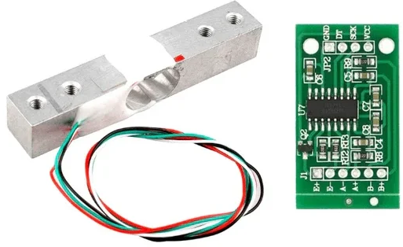
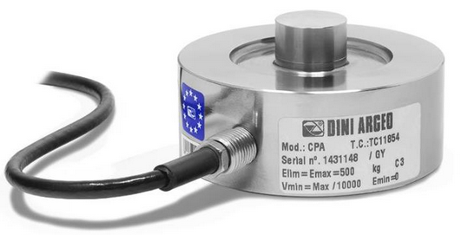
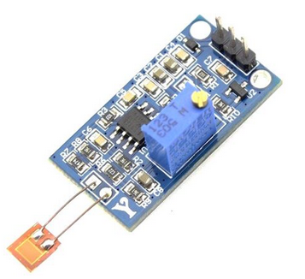
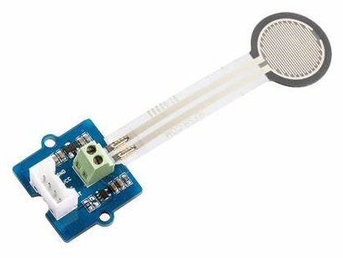
Industrial IoT and Industry 4.0
Load Cell
HX711_Load Cell
Force Sensor
Load Cell Module
Tektork Private Limited, Coimbatore

Slide 63
Industrial IoT and Industry 4.0
How They Work
The most common type of force and weight sensor uses strain gauges. A strain gauge is a resistor that changes its electrical resistance when it is stretched or compressed.
Sensing Body: The sensor has a metal body (often called the "flexure" or "spring element") designed to deform slightly under applied force.
Strain Gauges: Several strain gauges are bonded to this body in specific patterns. When a force is applied (whether it's tension, compression, or shear), the body deforms, and the strain gauges stretch or contract.
Wheatstone Bridge: The strain gauges are wired into an electrical circuit called a Wheatstone bridge
Tektork Private Limited, Coimbatore

Slide 64
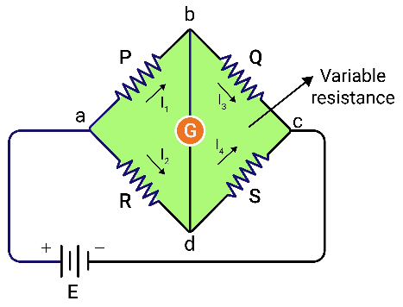
Industrial IoT and Industry 4.0
This circuit is highly sensitive to the small changes in resistance of the strain gauges.
Signal Output: As the resistance changes, the voltage output of the Wheatstone bridge changes proportionally. This voltage is then amplified and converted into a digital reading that corresponds to the applied force or weight.
Tektork Private Limited, Coimbatore

Slide 65
Industrial IoT and Industry 4.0
Sensor Types
Strain Gauge Load Cells:
For precise industrial and commercial weighing. Common forms are compression, tension, shear, and single-point load cells
Use strain gauges attached to a deformable element (beam, diaphragm, etc.).
When a force/weight is applied → material deforms → strain gauge resistance changes → electrical signal.
Applications: Weighing machines, industrial scales, robotics.
Advantages: High accuracy, reliable.
Example: Wheatstone bridge configuration in load cells.
Tektork Private Limited, Coimbatore

Slide 66
Industrial IoT and Industry 4.0
Sensor Types
Capacitive Force Sensors
Used where small, precise force readings are needed, e.g., touch screens.
Force deforms a diaphragm, changing capacitance between plates.
Compact and sensitive.
Applications: Touch sensors, robotics grippers, biomedical devices.
Tektork Private Limited, Coimbatore

Slide 67
Industrial IoT and Industry 4.0
Sensor Types
Piezoelectric Sensors
Ideal for dynamic measurements and high-speed force applications.
Use piezoelectric materials (quartz, PZT) that generate voltage when force is applied.
Good for dynamic force measurements (fast changes).
Not ideal for static weight measurement (charge leaks over time).
Applications: Impact testing, vibration monitoring, automotive crash tests.
Tektork Private Limited, Coimbatore

Slide 68
Industrial IoT and Industry 4.0
Sensor Types
Hydraulic and Pneumatic Load Cells
Suited for rugged and heavy-duty weighing, especially where electrical power is unreliable or absent.
Force compresses fluid → pressure change is measured.
Rugged, used for very large loads.
Applications: Heavy-duty industrial weighing, truck scales.
Tektork Private Limited, Coimbatore

Slide 69
Industrial IoT and Industry 4.0
Sensor Types
Force-Sensing Resistors (FSRs)
Change resistance as force is applied; useful in tactile and low-force applications.
Magnetic / Electromagnetic Force Sensors
Use changes in magnetic field when force displaces a magnetic element.
Less common but used in specialized cases.
Tektork Private Limited, Coimbatore

Slide 70
Industrial IoT and Industry 4.0
Common Examples
HX711 + Load Cell → Widely used in Arduino/ESP32 IoT weighing projects.
Strain Gauge Beam Load Cell → Kitchen scales, luggage scales.
Piezoelectric Discs → Force-sensitive applications.
Tektork Private Limited, Coimbatore

Slide 71
Industrial IoT and Industry 4.0
Applications
Weighing scales (industrial, retail, personal)
Robotics, prosthetics, and medical devices
Material testing, manufacturing quality control
Automotive (e.g., brake and seatbelt force monitoring)
Smart appliances and consumer electronics
Tektork Private Limited, Coimbatore

Slide 72
Industrial IoT and Industry 4.0
Motion and position sensors
Motion and position sensors are devices that detect movement, displacement, or the location of an object and convert that information into an electrical signal.
While they are often discussed together, they serve different primary functions.
Motion sensors detect whether an object is moving or not, while position sensors measure the specific location or displacement of an object.
They are essential in industrial automation, robotics, automotive systems, medical devices, and consumer electronics.
Tektork Private Limited, Coimbatore

Slide 73
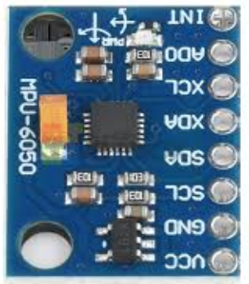
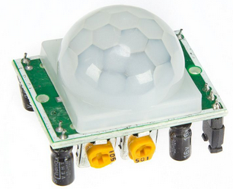
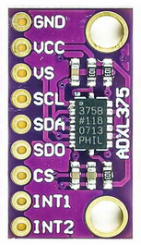
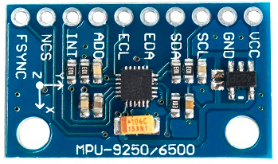
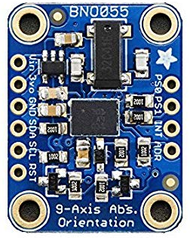
Industrial IoT and Industry 4.0
MPU 6050
6-axis (Gyro + Accel)
PIR modules (HC-SR501)
ADXL375
( Accel)
MPU 9250
9-axis (Gyro + Accel + Magn)
BNO055
Orientation
Ultrasonic (HC-SR04)
Tektork Private Limited, Coimbatore

Slide 74
Industrial IoT and Industry 4.0
Motion Sensors
Motion sensors detect movement within a specific area and are commonly used for security systems and automated lighting.
They typically provide a simple binary output: either an object is moving (ON) or it is not (OFF).
Tektork Private Limited, Coimbatore

Slide 75
Industrial IoT and Industry 4.0
Common Types of Motion Sensors
Passive Infrared (PIR):
These sensors detect the heat (infrared radiation) emitted by a living body.
When a warm body moves into the sensor's field of view, it causes a change in the detected IR energy, triggering the sensor.
Detect human/animal motion by sensing IR radiation changes.
PIR sensors are common in home security systems and automatic lights.
Applications: Security systems, automatic lights.
Tektork Private Limited, Coimbatore

Slide 76
Industrial IoT and Industry 4.0
Ultrasonic:
These sensors emit high-frequency sound waves and measure the time it takes for the waves to bounce back.
The sensor detects motion by analyzing changes in the echo, which indicates a moving object. They are often used in automatic doors and parking sensors.
Applications: Obstacle detection, intrusion alarms.
Tektork Private Limited, Coimbatore

Slide 77
Industrial IoT and Industry 4.0
Accelerometers
Measure acceleration along axes and, by integration, can track movement, tilt vibration.
Widely used in smart devices and vehicle systems.
Can detect orientation (tilt with respect to gravity).
Examples: ADXL345, MPU6050 (accelerometer + gyroscope).
Applications: Smartphones (screen rotation), vibration monitoring, fitness trackers.
Tektork Private Limited, Coimbatore

Slide 78
Industrial IoT and Industry 4.0
Gyroscopes
Measure angular velocity; used alongside accelerometers for full motion tracking (e.g., IMUs).
Often combined with accelerometers for 6-DOF motion sensing.
Applications: Drones (stability), navigation systems, VR controllers.
Tektork Private Limited, Coimbatore

Slide 79
Industrial IoT and Industry 4.0
Fibre Optic Sensors
Use light in optical fibers; resilient to electromagnetic noise and suited for structural or remote monitoring.
Microwave:
Similar to ultrasonic sensors, these emit microwave radiation and detect motion based on the Doppler effect, which is a change in the frequency of the reflected waves caused by a moving object.
They can cover large areas and can even "see" through some non-metallic walls.
Tektork Private Limited, Coimbatore

Slide 80
Industrial IoT and Industry 4.0
Common Types of Position Sensors
Potentiometers
These are contact-based sensors that use a sliding or rotating contact (a "wiper") on a resistive track.
As the object moves, the wiper's position changes, altering the resistance and producing a proportional voltage output.
Applications: Joysticks, volume controls, robotic arms.
Tektork Private Limited, Coimbatore

Slide 81
Industrial IoT and Industry 4.0
Linear Variable Differential Transformer (LVDT)
An LVDT is a highly accurate, non-contact sensor(Electromagnetic Transducer) used for measuring linear displacement.
It consists of a movable magnetic core inside three coils.
When the core moves, it changes the voltage induced in the secondary coils, providing an output signal proportional to its position.
Applications: Aerospace, industrial machinery, research labs.
Tektork Private Limited, Coimbatore

Slide 82
Industrial IoT and Industry 4.0
Hall Effect Sensors
These sensors detect changes in a magnetic field. When a magnet attached to a moving object passes by the sensor, it changes the magnetic field, and the Hall effect sensor produces a voltage output that corresponds to the object's position.
They are non-contact and immune to dirt and debris.
Applications: Wheel speed detection, brushless DC motor commutation, automotive position sensing.
Tektork Private Limited, Coimbatore

Slide 83
Industrial IoT and Industry 4.0
Encoders
Encoders are used to measure position and speed, especially rotation.
They consist of a rotating disk with a coded pattern (either optical or magnetic) that is read by a sensor.
By counting the pulses or reading the pattern, the encoder can determine the exact angular position of a shaft.
Types:
Rotary Encoders (absolute or incremental) → detect shaft rotation.
Linear Encoders → detect linear displacement.
Applications: CNC machines, robotics, industrial automation.
Tektork Private Limited, Coimbatore

Slide 84
Industrial IoT and Industry 4.0
Optical Encoders/Sensors
Rely on changes in light interruption or reflection to accurately determine linear or rotational position; critical for robotics and precise CNC machines
Use light interruption/reflection to detect position.
Applications: Printers, optical mice, robotics.
Tektork Private Limited, Coimbatore

Slide 85
Industrial IoT and Industry 4.0
Combined Motion & Position Sensors in IoT
MPU6050 / MPU9250 → Accelerometer + Gyroscope (+ Magnetometer).
BNO055 → 9-axis absolute orientation sensor.
PIR modules (HC-SR501) → Motion detection.
Ultrasonic (HC-SR04) → Distance + movement tracking.
Tektork Private Limited, Coimbatore

Slide 86
Industrial IoT and Industry 4.0
Applications
Robotics, automation, and precision manufacturing
Vehicle and drone navigation (steering, stability, safety)
Process control and level/distance measurement
Smart devices (cell phones, gaming, wearables)
Medical diagnostics and patient monitoring
Tektork Private Limited, Coimbatore

Slide 87
Industrial IoT and Industry 4.0
Chemical and Gas Sensors
Chemical and gas sensors are devices that detect and measure the presence and concentration of gases or chemical substances in the environment by converting chemical interactions into electrical signals.
They are vital in safety, environmental monitoring, industrial automation, healthcare, and IoT applications.
Tektork Private Limited, Coimbatore

Slide 88
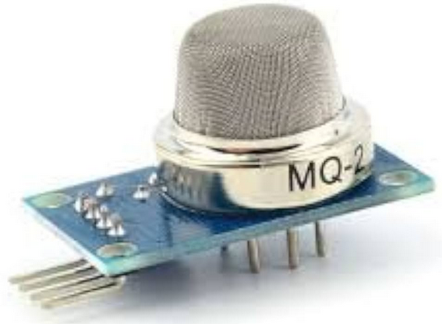
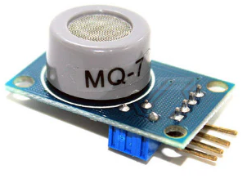
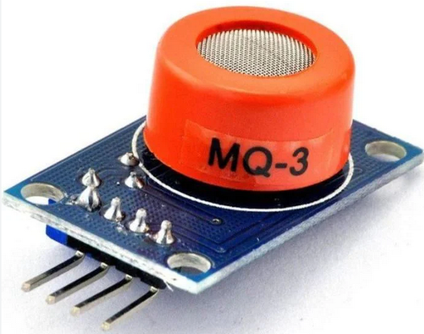
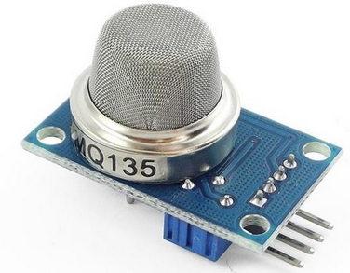
Industrial IoT and Industry 4.0
MQ - 2
MQ - 7
MQ - 3
MQ - 135
Tektork Private Limited, Coimbatore

Slide 89
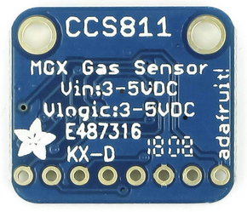
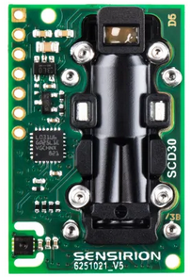
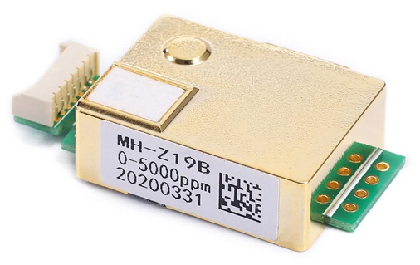
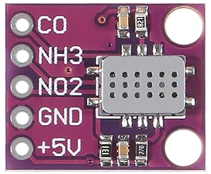
Industrial IoT and Industry 4.0
CCS811
SCD30
MH-Z19
MCS 6814
Tektork Private Limited, Coimbatore

Slide 90
Industrial IoT and Industry 4.0
Working Principle
Most chemical and gas sensors operate by using a sensing element that changes its physical or electrical properties when it interacts with the target substance.
This change is then converted into a measurable electrical signal.
The specific mechanism varies depending on the sensor type:
Change in Resistance
Many sensors, like metal oxide semiconductor (MOS) sensors, have a sensing layer whose electrical resistance changes when gas molecules adsorb onto its surface.
Tektork Private Limited, Coimbatore

Slide 91
Industrial IoT and Industry 4.0
Electrochemical Reaction
In electrochemical sensors, the target gas undergoes an oxidation or reduction reaction at an electrode, generating an electrical current proportional to the gas concentration.
Absorption of Light
Infrared (IR) gas sensors work by shining an IR light beam through a gas sample.
The sensor measures how much of the light is absorbed, as each gas absorbs specific wavelengths of infrared light.
Catalytic Reaction
Catalytic bead sensors detect combustible gases. They contain a heated element with a catalyst that causes the gas to burn.
The heat from this reaction changes the element's resistance, which is then measured.
Tektork Private Limited, Coimbatore

Slide 92
Industrial IoT and Industry 4.0
Common Types of Sensors
Gas Sensors
Gas sensors are designed to detect a specific type or a narrow range of gases.
Semiconductor (MOS) Sensors
These are a very common and inexpensive type used for detecting gases like carbon monoxide (CO), methane, and volatile organic compounds (VOCs).
Electrochemical Sensors: Known for their high accuracy and low power consumption, these are often used to detect toxic gases like carbon monoxide and hydrogen sulfide (H2​S) at low concentrations.
Examples: MQ-series (MQ-2, MQ-3, MQ-7, MQ-135).
Applications: LPG, methane, alcohol, smoke, air quality monitoring.
Tektork Private Limited, Coimbatore

Slide 93
Industrial IoT and Industry 4.0
Catalytic Sensors
Primarily used to detect flammable gases like propane and methane by measuring the heat generated when the gas burns on a catalytic bead.
Infrared (IR) Sensors
These are highly selective, long-lasting, and immune to "poisoning" from other chemicals.
They are ideal for detecting gases that absorb IR light, such as carbon dioxide (CO2​) and hydrocarbons.
Non-dispersive infrared (NDIR) sensors use light absorption differences to quantify gas concentration.
Applications: CO₂ monitoring in HVAC, greenhouses, industrial safety.
Tektork Private Limited, Coimbatore

Slide 94
Industrial IoT and Industry 4.0
Chemical Sensors
Chemical sensors are a broader category that can include gas sensors but also devices for detecting liquid or solid chemicals.
Biosensors
These are highly specific sensors that use a biological component, like an enzyme or antibody, to detect a specific chemical or biological substance.
They are widely used in medical diagnostics to measure blood glucose, for example.
Optical Sensors
These use light to analyze chemical properties. An example is a colorimetric sensor, which changes color in the presence of a specific chemical, and the color change is measured by a detector.
Tektork Private Limited, Coimbatore

Slide 95
Industrial IoT and Industry 4.0
Potentiometric Sensors
These measure the electrical potential or voltage of a solution to determine the concentration of a specific ion.
A pH meter is a classic example of a potentiometric chemical sensor.
Electrochemical Sensors
Use electrodes and electrolytes where the target gas undergoes oxidation or reduction reactions.
The resulting flow of ions and electrons produces a current proportional to gas concentration.
Used for toxic gas detection such as CO, H2S, and oxygen levels.
Tektork Private Limited, Coimbatore

Slide 96
Industrial IoT and Industry 4.0
Catalytic (Pellistor) Sensors
Work by oxidizing combustible gases on a catalyst, releasing heat that changes a sensor bead’s resistance.
Used for flammable gases detection in hazardous environments.
Detect combustible gases (LPG, methane, hydrogen) by oxidizing them on a heated catalyst → changes resistance.
Rugged, but require oxygen to operate.
Applications: Gas leak detectors, mining safety.
Tektork Private Limited, Coimbatore

Slide 97
Industrial IoT and Industry 4.0
Common Chemical & Gas Sensors in IoT/Embedded Systems
MQ-2 → LPG, methane, smoke.
MQ-3 → Alcohol detection (breathalyzer).
MQ-7 → Carbon monoxide (CO).
MQ-135 → Air quality (NH₃, NOx, benzene, CO₂).
CCS811 → Indoor air quality (eCO₂, TVOCs).
MH-Z19 / SCD30 / Senseair → CO₂ NDIR sensors.
MiCS-6814 → Multiple gases (CO, NO₂, NH₃).
Tektork Private Limited, Coimbatore

Slide 98
Industrial IoT and Industry 4.0
Applications
Industrial safety (toxic and combustible gas detection)
Environmental monitoring and air quality control
Medical diagnostics (oxygen sensors, anesthesia monitoring)
HVAC and building automation
Automotive emissions control and detection
Tektork Private Limited, Coimbatore

Slide 99
Industrial IoT and Industry 4.0
Biosensors
A biosensor is an analytical device that detects a specific biological or chemical substance, known as an analyte, and converts its presence or concentration into a measurable electrical or optical signal.
They combine a biological recognition element with a physicochemical transducer.
Tektork Private Limited, Coimbatore

Slide 100
Industrial IoT and Industry 4.0
Working Principle
The basic principle of a biosensor involves three main parts:
Bioreceptor
This is the biological component, such as an enzyme, antibody, nucleic acid (DNA), or even a living cell.
Its job is to specifically bind to or interact with the target analyte. This interaction is the key to the sensor's high selectivity.
Transducer
This component converts the biological event (the interaction between the bioreceptor and the analyte) into a quantifiable signal.
For example, a transducer might detect a change in electrical current, light absorption, or heat generated by the reaction.
Tektork Private Limited, Coimbatore

Slide 101
Industrial IoT and Industry 4.0
Working Principle
Electronic System
This part processes the signal from the transducer, amplifies it, and displays the result in a user-friendly format, such as a number on a screen.
Common transducer mechanisms include electrochemical, optical, piezoelectric, and thermal signals.
Tektork Private Limited, Coimbatore

Slide 102
Industrial IoT and Industry 4.0
Components
Analyte: The substance to be measured (e.g., glucose, toxins, pathogens).
Bioreceptor: Enzymes, antibodies, DNA, cells, or aptamers that selectively bind the analyte.
Transducer: Converts biochemical response into measurable signals.
Electronics: Amplifies and processes the transduced signal.
Display: Presents results to the user clearly.
Tektork Private Limited, Coimbatore

Slide 103
Industrial IoT and Industry 4.0
Types of Biosensors
Electrochemical Biosensors
Measure current, voltage, or impedance caused by biochemical reactions.
Examples: Glucose sensors, lactate sensors.
Applications: Diabetes monitoring, blood chemistry analysis.
Optical Biosensors
Use light absorption, fluorescence, or surface plasmon resonance (SPR).
Examples: DNA hybridization sensors, immunosensors.
Applications: Pathogen detection, cancer diagnostics.
Tektork Private Limited, Coimbatore

Slide 104
Industrial IoT and Industry 4.0
Thermal Biosensors
Measure heat generated or absorbed during biochemical reactions.
Applications: Metabolic activity monitoring, enzyme assays.
Piezoelectric / Mass-based Biosensors
Detect changes in mass or resonance frequency when biomolecules bind.
Examples: Quartz Crystal Microbalance (QCM).
Applications: Viral/bacterial detection, biomarker sensing.
Wearable Biosensors
Integrated into wearable devices → measure physiological parameters.
Examples: Sweat sensors, heart rate monitors, oxygen saturation (SpO₂) sensors.
Tektork Private Limited, Coimbatore

Slide 105
Industrial IoT and Industry 4.0
Applications
Medical diagnostics (glucose monitoring, pathogen detection)
Environmental monitoring (pollutant detection)
Food safety and agriculture
Biotechnology and pharmaceutical research
Wearable health devices
Tektork Private Limited, Coimbatore

Slide 106
Industrial IoT and Industry 4.0
Signal Conditioning of Sensors and Transducers
Op-amps can be used to provide amplification of signals when connected in either inverting or non-inverting configurations.
The very small analogue signal voltages produced by a sensor such as a few milli-volts or even pico-volts can be amplified many times over by a simple op-amp circuit to produce a much larger voltage signal of say 5v or 5mA that can then be used as an input signal to a microprocessor or analogue-to-digital based system.
Therefore, to provide any useful signal a sensors output signal has to be amplified with an amplifier that has a voltage gain up to 10,000 and a current gain up to 1,000,000 with the amplification of the signal being linear with the output signal being an exact reproduction of the input, just changed in amplitude.
Tektork Private Limited, Coimbatore

Slide 107
Industrial IoT and Industry 4.0
Signal Conditioning of Sensors and Transducers Contd..
Then amplification is part of signal conditioning. So when using analogue sensors, generally some form of amplification (Gain), impedance matching, isolation between the input and output or perhaps filtering (frequency selection) may be required before the signal can be used and this is conveniently performed by Operational Amplifiers.
Also, when measuring very small physical changes the output signal of a sensor can become “contaminated” with unwanted signals or voltages that prevent the actual signal required from being measured correctly.
These unwanted signals are called “Noise“. This Noise or Interference can be either greatly reduced or even eliminated by using signal conditioning or filtering techniques as we discussed in the Active Filter tutorial.
Tektork Private Limited, Coimbatore

Slide 108
Industrial IoT and Industry 4.0
Signal Conditioning of Sensors and Transducers Contd..
By using either a Low Pass, or a High Pass or even Band Pass filter the “bandwidth” of the noise can be reduced to leave just the output signal required.
For example, many types of inputs from switches, keyboards or manual controls are not capable of changing state rapidly and so low-pass filter can be used.
When the interference is at a particular frequency, for example mains frequency, narrow band reject or Notch filters can be used to produce frequency selective filters.
Tektork Private Limited, Coimbatore

Slide 109
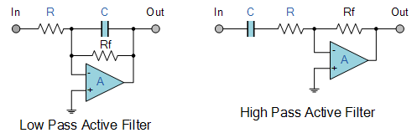
Industrial IoT and Industry 4.0
Typical Op-amp Filters
Were some random noise still remains after filtering it may be necessary to take several samples and then average them to give the final value so increasing the signal-to-noise ratio.
Either way, both amplification and filtering play an important role in interfacing both sensors and transducers to microprocessor and electronics based systems in “real world” conditions.
Tektork Private Limited, Coimbatore

Slide 110
Industrial IoT and Industry 4.0
Sensor Signal Conditioning
Sensor signal conditioning involves various techniques to prepare sensor outputs for accurate measurement, processing, and analysis.
The main goal is to take raw sensor signals and make them suitable for use by data acquisition systems, controllers, or digital processors.
Signal Conditioning Techniques
Amplification
Filtering
Isolation
Linearization
Excitation
Conversion
Temperature Compensation
Tektork Private Limited, Coimbatore

Slide 111
Industrial IoT and Industry 4.0
Sensor Signal Conditioning Techniques
Amplification
Boosts weak sensor signals, such as those from strain gauges or load cells, to a level suitable for measurement. Instrumentation amplifiers or differential amplifiers are commonly used to enhance signal strength while minimizing noise and interference.
Boosts small signals to a measurable range.
Example: Thermocouple (mV output) → amplified to volts.
Circuit: Operational Amplifiers (Op-Amps).
Tektork Private Limited, Coimbatore

Slide 112
Industrial IoT and Industry 4.0
Filtering
Removes unwanted noise or frequency components from the sensor output. Filters can be low-pass, high-pass, band-pass, or band-reject depending on the signal and application. Filtering helps in stabilizing signals and improving measurement accuracy.
Low-pass filters → remove high-frequency noise.
High-pass filters → remove DC offsets.
Band-pass filters → extract desired frequency band.
Tektork Private Limited, Coimbatore

Slide 113
Industrial IoT and Industry 4.0
Isolation
Electrically isolates the sensor signal path to prevent ground loops, voltage surges, and interference. This is crucial for maintaining signal integrity, especially in industrial and high-voltage environments.
Protects system and avoids ground loops.
Achieved with opto-isolators or transformers.
Tektork Private Limited, Coimbatore

Slide 114
Industrial IoT and Industry 4.0
Linearization
Corrects non-linear sensor outputs so that the signal accurately corresponds to the measured parameter in a linear manner. This processing can be performed using specialized circuitry or software.
Many sensors have non-linear response (e.g., thermistors).
Signal conditioning circuits or software can map it to a linear scale.
Tektork Private Limited, Coimbatore

Slide 115
Industrial IoT and Industry 4.0
Excitation (Biasing/Powering the Sensor)
Provides necessary power (voltage or current) to active sensors, such as RTDs or strain gauges, which require external excitation to function correctly.
Some sensors (e.g., strain gauges, RTDs) require an external excitation voltage or current source.
Tektork Private Limited, Coimbatore

Slide 116
Industrial IoT and Industry 4.0
Conversion - Analog-to-Digital Conversion (ADC)
Converts the sensor output signal from one form to another to ensure compatibility with the next stage of processing. This includes analog-to-digital conversion (ADC) for digital processing or voltage-to-current conversion for transmission.
Converts conditioned analog signals into digital format for microcontrollers.
Often integrated into signal conditioning systems.
Tektork Private Limited, Coimbatore

Slide 117
Industrial IoT and Industry 4.0
Temperature Compensation
Adjusts for variations in sensor output caused by temperature changes to maintain consistent accuracy.
Tektork Private Limited, Coimbatore

Slide 118
Industrial IoT and Industry 4.0
Applications of Signal Conditioning
Signal conditioning circuits are essential in a wide variety of industries and applications:
Industrial weighing systems (load cells)
Pressure and temperature measurement
Vibration analysis and structural monitoring
Medical instrumentation
Automotive testing
Environmental and agricultural monitoring
Tektork Private Limited, Coimbatore

Slide 119
Industrial IoT and Industry 4.0
Signal Conditioning is Essential
Without proper signal conditioning, the raw data from a sensor can be unusable. It ensures that the signal is:
Compatible: It matches the voltage and current requirements of the next stage (e.g., an ADC).
Clean: Unwanted noise and interference are removed.
Accurate: The signal is a true and correct representation of the physical quantity being measured.
Safe: It protects sensitive and expensive data acquisition equipment from potential damage.
Tektork Private Limited, Coimbatore

Slide 120
Industrial IoT and Industry 4.0
Amplification
Amplification is the process of increasing the amplitude of a sensor's output signal. Many sensors, particularly those measuring physical quantities like temperature, pressure, or strain, produce very weak signals, often in the millivolt or microvolt range.
These low-level signals are susceptible to noise and are often too small to be directly processed by an analog-to-digital converter (ADC), which typically has a specific input voltage range (e.g., ±5 V).
Tektork Private Limited, Coimbatore

Slide 121
Industrial IoT and Industry 4.0
Amplification serves two primary purposes:
Voltage Level Matching:
It boosts the signal's voltage to the required level for the ADC, preventing inaccurate readings or potential damage to the converter.
Improving Signal-to-Noise Ratio (SNR)
By increasing the signal's amplitude, amplification makes it stronger relative to the inherent electronic noise in the system.
This leads to a higher SNR, which in turn results in more accurate and reliable measurements.
Tektork Private Limited, Coimbatore

Slide 122
Industrial IoT and Industry 4.0
Operational Amplifiers (Op-Amps)
Widely used due to their versatility, high input impedance, and low output impedance. They can be configured to provide precise gain and filtering.
Instrumentation Amplifiers
Specialized for sensor conditioning, they provide high gain, excellent noise rejection, and differential signal amplification which is useful in noisy environments.
Gain Control
The amplifier gain determines the extent of signal amplification. Too much gain can saturate the amplifier, while too little may yield poor signal resolution.
Tektork Private Limited, Coimbatore

Slide 123
Industrial IoT and Industry 4.0
Filtering
Filtering is the process of removing unwanted frequency components, or noise, from a sensor signal.
All electronic signals are susceptible to noise from various sources, such as ambient electromagnetic interference (EMI) or the sensor's own internal electronics.
This noise can obscure the true signal, leading to inaccurate readings.
There are several types of filters, each designed to address different types of noise:
Low-pass filters
High-pass filters
Band-pass filters
Notch filters
Tektork Private Limited, Coimbatore

Slide 124
Industrial IoT and Industry 4.0
Low-pass filters
Low-pass filters allow low-frequency signals (the desired signal) to pass while attenuating high-frequency noise.
This is the most common type of filter used in sensor applications, as most physical phenomena change relatively slowly.
High-pass filters
High-pass filters allow high-frequency signals to pass while blocking low-frequency signals.
These can be used to remove unwanted DC offsets or slow-changing drift from a signal.
Tektork Private Limited, Coimbatore

Slide 125
Industrial IoT and Industry 4.0
Band-pass filters
Band-pass filters allow a specific range of frequencies to pass while rejecting frequencies both above and below that band.
Notch filters
Notch filters are a type of band-stop filter that rejects a very narrow band of frequencies.
They are particularly useful for removing specific, known noise frequencies like 50/60 Hz power line noise.
Tektork Private Limited, Coimbatore

Slide 126
Industrial IoT and Industry 4.0
Filtering can be implemented using either analog circuits (resistors and capacitors) or digital signal processing (DSP) after the signal has been digitized.
Analog filtering is often performed before amplification to remove as much noise as possible before the signal is boosted.
Reduces noise picked up from electromagnetic interference (EMI) or other sources.
Prevents aliasing in analog-to-digital conversion by limiting the bandwidth.
Tektork Private Limited, Coimbatore

Slide 127
Industrial IoT and Industry 4.0
Analog-to-Digital Conversion (ADC)
Analog-to-Digital Conversion (ADC) is a critical step in sensor signal conditioning that transforms a continuous analog signal into a discrete digital one.
This conversion is necessary because most modern microcontrollers and digital processors only understand binary data (0s and 1s).
The ADC acts as the bridge, allowing the conditioned sensor signal to be read, stored, and analyzed by a digital system.
Tektork Private Limited, Coimbatore

Slide 128
Industrial IoT and Industry 4.0
The conversion process involves two key steps:
sampling and quantization.
Sampling
The ADC doesn't read the analog signal continuously.
Instead, it takes "snapshots" or samples of the signal's voltage at regular, precise time intervals.
The sampling rate (or sampling frequency) determines how often these snapshots are taken, and it's measured in samples per second (SPS) or hertz (Hz).
According to the Nyquist-Shannon sampling theorem, the sampling rate must be at least twice the highest frequency component of the analog signal to accurately reproduce it digitally and avoid an issue called aliasing.
Tektork Private Limited, Coimbatore

Slide 129
Industrial IoT and Industry 4.0
Quantization
Once a sample is taken, the ADC approximates its continuous voltage value to the nearest discrete level.
The number of available discrete levels is determined by the ADC's resolution, which is expressed in bits.
An n-bit ADC has 2n distinct output levels. For example, a 10-bit ADC has 210=1024 possible output values, from 0 to 1023.
Higher resolution means more discrete levels, which results in a more precise digital representation of the analog signal and less quantization error.
Tektork Private Limited, Coimbatore

Slide 130
Industrial IoT and Industry 4.0
Input Range Matching
The sensor signal conditioning amplifies and scales the sensor output to match the ADC input range, maximizing use of the full range for better resolution and accuracy.
Anti-aliasing Filtering
Before conversion, low-pass filters remove high-frequency noise that could interfere with sampling, preventing distortion in digital output.
Tektork Private Limited, Coimbatore

Slide 131
Industrial IoT and Industry 4.0
ADC Characteristics
Resolution:
The number of bits in the ADC's output, which determines the precision of the conversion.
A higher-bit ADC provides a more accurate digital representation.
Sampling Rate:
The speed at which the ADC takes samples.
A higher sampling rate is needed for fast-changing signals (high-frequency signals) to prevent data loss or distortion.
Tektork Private Limited, Coimbatore

Slide 132
Industrial IoT and Industry 4.0
Accuracy and Linearity:
These parameters describe how well the ADC's digital output corresponds to the actual analog input.
Integral Nonlinearity (INL) and Differential Nonlinearity (DNL) are common metrics used to measure an ADC's linearity.
Tektork Private Limited, Coimbatore

Slide 133
Industrial IoT and Industry 4.0
Common ADC Architectures for Sensor Systems
Different ADC architectures offer trade-offs between speed, resolution, power consumption, and cost.
Successive Approximation Register (SAR) ADC
This is one of the most common types. SAR ADCs are versatile, offering a good balance of speed (up to a few Msps) and resolution (typically 8 to 16 bits).
They're widely used in a variety of midrange applications.
Tektork Private Limited, Coimbatore

Slide 134
Industrial IoT and Industry 4.0
Delta-Sigma (ΔΣ) ADC
This architecture excels at high-resolution conversions (up to 24 bits or more) for low-speed, low-frequency signals.
They use oversampling and noise shaping to achieve high accuracy, making them ideal for precision applications like temperature or weight measurements.
Flash ADC
Known for its extreme speed (hundreds of Msps or even Gsps), the Flash ADC is the fastest type of converter.
However, it requires a large number of components, making it expensive and power-hungry. It's used in high-frequency applications like digital oscilloscopes or high-speed data acquisition.
Tektork Private Limited, Coimbatore

Slide 135
Industrial IoT and Industry 4.0
Important ADC Specs
Parameter | Description
Resolution | Number of bits (e.g., 12-bit ADC gives 4096 levels)
Sampling Rate | How often the signal is sampled (Hz)
Input Range | Voltage range the ADC can accept
Accuracy | How close the digital value is to the actual signal
SNR | Signal-to-noise ratio, critical for precision
Tektork Private Limited, Coimbatore

Slide 136
Industrial IoT and Industry 4.0
Digital Signal Processing (DSP) for Sensors
Digital Signal Processing (DSP) involves the numerical manipulation of signals after they have been converted from analog to digital form.
For sensors, DSP plays a crucial role in enhancing, analyzing, and interpreting sensor data to improve accuracy, reliability, and functionality.
DSP techniques can be applied to:
Filter out noise
Extract features
Compress data
Detect patterns or anomalies
Improve accuracy and reliability
Tektork Private Limited, Coimbatore

Slide 137
Industrial IoT and Industry 4.0
DSP Techniques for Sensors
Technique | Purpose | Example Use Case
Filtering | Removes unwanted noise or interference | Low-pass filter for ECG signals
Fourier Transform (FFT) | Converts signal to frequency domain | Vibration analysis in motors
Windowing | Reduces spectral leakage in FFT | Audio signal analysis
Decimation & Interpolation | Adjusts sampling rate for efficiency | Downsampling accelerometer data
Feature Extraction | Identifies key signal characteristics | Gesture recognition from IMU sensors
Adaptive Filtering | Dynamically adjusts to changing conditions | Noise cancellation in microphones
Tektork Private Limited, Coimbatore

Slide 138
Industrial IoT and Industry 4.0
Applications of DSP for Sensors
Advanced Filtering
While analog filters are limited, DSP enables the creation of highly precise and configurable digital filters.
These can effectively remove a wide range of noise types and are essential for isolating the desired signal from complex background noise.
For example, a notch filter can be used to specifically remove 50/60 Hz power line noise from a biomedical sensor signal like an ECG.
Tektork Private Limited, Coimbatore

Slide 139
Industrial IoT and Industry 4.0
Linearization and Calibration
Many sensors have a non-linear response. Instead of using complex analog circuits, DSP algorithms can correct for this non-linearity with high precision.
They can also perform calibration, adjusting the sensor's output to account for environmental factors, aging, or manufacturing variations, ensuring consistent and accurate readings over time.
Tektork Private Limited, Coimbatore

Slide 140
Industrial IoT and Industry 4.0
Frequency Analysis
The Fast Fourier Transform (FFT) is a fundamental DSP algorithm that converts a signal from the time domain to the frequency domain.
This is invaluable for applications like vibration analysis, where identifying specific frequency components can help diagnose mechanical issues in a machine.
Tektork Private Limited, Coimbatore

Slide 141
Industrial IoT and Industry 4.0
Sensor Fusion
In many modern systems, data is collected from multiple sensors (e.g., an accelerometer, gyroscope, and magnetometer in a smartphone).
DSP is used to fuse this data, combining the individual readings to provide a more accurate, reliable, and complete picture of the system's state.
This is crucial for applications like navigation and robotics.
Tektork Private Limited, Coimbatore

Slide 142
Industrial IoT and Industry 4.0
Data Compression
DSP can be used to compress large amounts of sensor data, reducing storage requirements and speeding up transmission.
This is especially important for IoT (Internet of Things) devices with limited bandwidth and memory.
Tektork Private Limited, Coimbatore

Slide 143
Industrial IoT and Industry 4.0
Signal Enhancement
Noise reduction, filtering, and signal smoothing improve sensor data quality by removing interference and unwanted components.
Feature Extraction and Pattern Recognition
DSP helps extract meaningful information from raw sensor data, enabling applications such as object detection, motion tracking, and biometric recognition.
Tektork Private Limited, Coimbatore

Slide 144
Industrial IoT and Industry 4.0
Motor and Stability Control
Real-time DSP algorithms control motors and mechanical systems based on sensor feedback to maintain system stability and precision.
IoT and Automation
DSP processes sensor data locally or remotely in IoT devices and industrial automation systems for predictive maintenance, monitoring, and control.
Tektork Private Limited, Coimbatore

Slide 145
Industrial IoT and Industry 4.0
Advantages of DSP over Analog Signal Processing
Flexibility
DSP is software-based, so algorithms can be easily changed or updated without modifying the hardware.
Accuracy and Repeatability
Digital processing is not affected by component drift, temperature changes, or other environmental factors that can degrade analog circuits.
This ensures that the same input always yields the same output.
Tektork Private Limited, Coimbatore

Slide 146
Industrial IoT and Industry 4.0
Advanced Capabilities
DSP allows for the implementation of complex algorithms and functions that are either impossible or too difficult to achieve with analog electronics.
Cost-Effectiveness
For many applications, a single, general-purpose Digital Signal Processor (DSP) chip can replace multiple analog components, reducing the overall size and cost of the system.
Tektork Private Limited, Coimbatore

Slide 147
Industrial IoT and Industry 4.0
Advantages of DSP in Sensor Systems
High accuracy and precision.
Flexible (algorithms can be changed in software).
Enables smart sensors (self-calibration, decision-making).
Supports IoT/AI integration.
Tektork Private Limited, Coimbatore

Slide 148
Industrial IoT and Industry 4.0
Common DSP Techniques Used in Sensor Applications
Fast Fourier Transform (FFT) for spectral analysis.
Adaptive filtering for noise cancellation.
Kalman filtering for sensor fusion and state estimation.
Wavelet transform for multi-resolution analysis.
Tektork Private Limited, Coimbatore

Slide 149
Industrial IoT and Industry 4.0
Tektork Private Limited, Coimbatore

Slide 150
Industrial IoT and Industry 4.0
Calibration and Compensation Techniques
Calibration
Calibration is the process of adjusting a sensor's output to match a known reference standard. It is a fundamental step that establishes the relationship between the sensor's input and output under controlled conditions.
This process helps to correct for systematic errors like offset (a non-zero output at zero input) and span/sensitivity errors (an incorrect slope of the output curve).
Tektork Private Limited, Coimbatore

Slide 151
Industrial IoT and Industry 4.0
Static Calibration
Measures sensor output at fixed, known input values.
Creates a correction curve mapping sensor output to true inputs.
Used for conditions that remain constant or change slowly, e.g., fixed temperature or pressure.
Dynamic Calibration
Evaluates sensor performance under changing inputs.
Assesses characteristics like frequency response and phase delay.
Important for applications with fast or varying signals.
Tektork Private Limited, Coimbatore

Slide 152
Industrial IoT and Industry 4.0
Two-Step Calibration
Separates calibration of the sensor element from calibration of analog signal conditioning circuits.
Improves accuracy by correcting errors introduced in both sensor and electronics.
Digital Calibration
Employs DSP algorithms to compensate for sensor and ADC offsets, gains, and nonlinearities.
Includes offset subtraction, gain scaling, and curve linearization.
Enables flexible, real-time compensation without hardware changes.
Tektork Private Limited, Coimbatore

Slide 153
Industrial IoT and Industry 4.0
Self-Calibration Techniques
Background Calibration
Continuous, non-intrusive calibration during normal operation to adjust sensor drift automatically.
Foreground Calibration
Scheduled calibration requiring stopping normal operation for precise adjustment.
Tektork Private Limited, Coimbatore

Slide 154
Industrial IoT and Industry 4.0
Point-Based Calibration Methods
Single-Point Calibration
Uses a single known reference.
Mainly corrects offset errors by adjusting output to zero at a known zero-input.
Simplest method but limited in addressing nonlinearities.
Two-Point Calibration
Uses two known references at the low and high ends of range.
Corrects offset and span (sensitivity) errors.
Suitable for ensuring linear scaling across sensor range.
Tektork Private Limited, Coimbatore

Slide 155
Industrial IoT and Industry 4.0
Multi-Point Calibration
Uses three or more calibration points across the range.
Corrects nonlinear sensor output with higher accuracy.
Generates lookup tables or applies curve-fitting algorithms like polynomial regression.
Tektork Private Limited, Coimbatore

Slide 156
Industrial IoT and Industry 4.0
Other Calibration Techniques
Curve Fitting
Mathematical modeling (linear, polynomial, nonlinear regression) to map sensor outputs to true values, especially for nonlinear sensors.
Gravimetric Calibration
For weighing sensors, compares outputs against known mass standards.
Electrical Calibration
Compares sensor electrical parameters (voltage/current) against traceable electrical standards for precision.
Tektork Private Limited, Coimbatore

Slide 157
Industrial IoT and Industry 4.0
Compensation
Compensation is the method of counteracting errors that a sensor experiences due to environmental factors or other external influences that change over time, such as temperature, humidity, or aging.
Unlike calibration, which is often done at a single point in time, compensation is a dynamic process that occurs continuously during operation.
Tektork Private Limited, Coimbatore

Slide 158
Industrial IoT and Industry 4.0
Temperature Compensation
Many sensors (RTDs, strain gauges, accelerometers) have outputs affected by temperature variations.
Methods:
Use an auxiliary temperature sensor to measure ambient temperature.
Apply hardware-based compensation by integrating components like thermistors in the sensor circuitry (e.g., Wheatstone bridge).
Implement software-based algorithms or lookup tables to correct sensor output based on temperature error models.
Use materials with low temperature coefficients to minimize temperature sensitivity.
Tektork Private Limited, Coimbatore

Slide 159
Industrial IoT and Industry 4.0
Software-Based Compensation
Builds mathematical models characterizing sensor behavior under varying conditions after calibration.
Real-time processing of raw sensor data using algorithms like polynomial curve fitting or machine learning (e.g., neural networks).
Offers flexibility and adaptability without hardware modification.
Tektork Private Limited, Coimbatore

Slide 160
Industrial IoT and Industry 4.0
Hardware-Based Compensation
Uses additional circuit components for direct error correction in the signal conditioning stage.
Example: Incorporates thermistors in Wheatstone bridges to counteract temperature-induced resistance changes.
Hysteresis Compensation
Minimizes output discrepancy caused by varying input history via algorithmic filtering or hardware techniques.
Tektork Private Limited, Coimbatore

Slide 161
Industrial IoT and Industry 4.0
Nonlinearity Compensation
Addresses nonlinear sensor output responses using polynomial curve fitting, lookup tables, or piecewise linear approximations.
Essential for sensors like thermistors and photodiodes exhibiting inherent nonlinear characteristics.
Aging and Drift Compensation
Compensates for sensor degradation and gradual output drift over time.
Uses periodic recalibration or continuous software drift tracking for sustained accuracy.
Tektork Private Limited, Coimbatore

Slide 162
Industrial IoT and Industry 4.0
Cross-Sensitivity Compensation
Corrects interference from multiple parameters affecting the sensor output (e.g., humidity sensors also sensitive to temperature).
Achieved by sensor fusion combining data from multiple sensors with algorithms.
Offset and Gain Adjustment
Corrects zero-level (offset) errors and scales sensitivity (gain) to align output with standards.
Often performed iteratively in analog sensors using zero and span adjustments.
Digital systems may use baseline subtraction or digital offset correction (e.g., auto-zeroing in op-amps, ADC offset compensation).
Tektork Private Limited, Coimbatore

Slide 163
Industrial IoT and Industry 4.0
Tektork Private Limited, Coimbatore

Slide 164
Industrial IoT and Industry 4.0
Sensor Interfaces and Communication
A sensor interface is the connection that allows a sensor to communicate with other devices, such as a microcontroller or a computer.
It's the "bridge" that enables the data collected by the sensor to be read, processed, and used.
Sensor Interfaces
Serve as a bridge between sensors and attached devices.
Facilitate reading out information from sensor signals and provide suitable output signals for easy integration.
Examples include sensor interface ICs that read complex sensor inputs and output processing-friendly data.
Tektork Private Limited, Coimbatore

Slide 165
Industrial IoT and Industry 4.0
Types of Sensor Interfaces
Sensor interfaces are broadly categorized based on how they transmit data:
Analog Interfaces
These interfaces transmit a continuous electrical signal, such as voltage or current, that is directly proportional to the measured physical quantity.
This raw data often requires signal conditioning (like amplification or filtering) and an analog-to-digital converter (ADC) to be read by a digital processing unit.
Tektork Private Limited, Coimbatore

Slide 166
Industrial IoT and Industry 4.0
Analog sensors output a continuous voltage or current proportional to the measured parameter.
Voltage Output
Example: LM35 temperature sensor (10 mV/°C).
Microcontroller reads it using ADC (Analog-to-Digital Converter).
Current Output (4–20 mA standard in industry)
Robust against noise and long-distance transmission.
Requires resistor → converts current to voltage before ADC.
Resistance/Capacitance Change
Example: LDR (resistance decreases with light).
Usually converted into voltage using a voltage divider or Wheatstone bridge.
Tektork Private Limited, Coimbatore

Slide 167
Industrial IoT and Industry 4.0
Digital Interfaces
These interfaces transmit data as a discrete stream of 1s and 0s, which is a format easily understood by microcontrollers.
They often include embedded electronics to perform tasks like signal conditioning and analog-to-digital conversion within the sensor itself.
Tektork Private Limited, Coimbatore

Slide 168
Industrial IoT and Industry 4.0
Digital sensors provide output in discrete form (binary, serial data, or pulse). They often have built-in ADC + signal conditioning.
Simple Digital Output
Output: HIGH/LOW (0 or 1).
Example: PIR motion sensor, IR obstacle sensor.
Pulse/Frequency Output
Sensor outputs a pulse train where frequency/duty cycle encodes the value.
Example: Ultrasonic sensor (HC-SR04), PWM output humidity sensors.
Tektork Private Limited, Coimbatore

Slide 169
Industrial IoT and Industry 4.0
Wireless Interfaces
These interfaces transmit data without physical cables using various radio frequencies.
They are a core component of the Internet of Things (IoT) and are used in applications where running wires is impractical.
Tektork Private Limited, Coimbatore

Slide 170
Industrial IoT and Industry 4.0
Sensor Communication
Communication is the process by which sensor data is transmitted from the sensor to a processing unit or network.
This is achieved through various communication protocols, which are the set of rules that govern data exchange.
Tektork Private Limited, Coimbatore

Slide 171
Industrial IoT and Industry 4.0
Wired Protocols
Low-Level Digital Communication: Protocols such as I2C, SPI, SENT, and HART are typically used for close-range sensor communication and provide reliable data transmission.
I2C: Two-wire, low-speed communication, suitable for multiple sensors on the same bus.
SPI: Four-wire, full-duplex, high-speed communication often used for sensors needing fast data transfer.
SENT: Serial protocol for transmitting sensor data in automotive applications.
Tektork Private Limited, Coimbatore

Slide 172
Industrial IoT and Industry 4.0
Wired Protocols cond..
Fieldbus Protocols: Used in industrial automation, including CAN (CANopen, CAN FD), Modbus RTU, and IO-Link.
Industrial Ethernet: Higher-layer communication protocols over Ethernet for industrial sensor networks.
Advantages
Secure, reliable, high-speed, and low latency.
Disadvantages
Limited mobility, can be complex and costly to install, and can be vulnerable to physical damage.
Tektork Private Limited, Coimbatore

Slide 173
Industrial IoT and Industry 4.0
Wireless Protocols
Protocols like WiFi, Bluetooth, Zigbee, LoRaWAN allow sensors to transmit data without physical wiring.
Wireless protocols enable flexibility and easy scalability but might have limitations in speed, interference, and power consumption.
Advantages
Flexible, scalable, and easy to deploy.
Disadvantages
Vulnerable to interference, security risks, and limited by battery life.
Tektork Private Limited, Coimbatore

Slide 174
Industrial IoT and Industry 4.0
Common Serial Communication Protocols
UART: Used for simple, asynchronous sensor communication.
RS-232, RS-485: Widely adopted in industrial settings; RS-485 allows multiple sensors on the same bus.
USB: Used for higher-speed sensor connections.
Tektork Private Limited, Coimbatore

Slide 175
Industrial IoT and Industry 4.0
Wireless Sensor Communication
Some sensors communicate over wireless standards:
Infrared (IR) → Remote sensors.
Bluetooth (BLE, BT Classic) → Wearables, IoT.
Wi-Fi → ESP32-based sensors.
Zigbee / LoRa → Long range, low power IoT applications.
Tektork Private Limited, Coimbatore

Slide 176
Industrial IoT and Industry 4.0
Industrial Communication Standards
For robust, long-distance environments:
RS-232 / RS-485 (differential signaling for noise immunity).
CAN bus (used in automotive sensors).
Modbus / Profibus / EtherCAT (industrial automation).
Tektork Private Limited, Coimbatore

Slide 177
Industrial IoT and Industry 4.0
Choosing the Right Interface
Short distance, low speed → I²C, UART.
High speed, short distance → SPI.
Long distance, noisy environment → 4–20 mA, RS-485, CAN.
IoT/Wireless → Wi-Fi, BLE, Zigbee, LoRa.
Tektork Private Limited, Coimbatore

Slide 178
Industrial IoT and Industry 4.0
Sensor Data Communication Characteristics
Data communication involves signal conversion, transmission, and interpretation by microcontrollers or processors.
Protocol selection depends on factors like data speed, wiring complexity, distance, power constraints, and system compatibility.
Protocols such as I2C and SPI are suited for embedded systems and short-distance communication, while CAN and Ethernet cater to more complex industrial needs.
Wireless protocols are preferred for IoT and smart devices where wiring is impractical.
Tektork Private Limited, Coimbatore

Slide 179
Industrial IoT and Industry 4.0
Table of Sensor Communication Protocols
Protocol Type | Advantage | Disadvantage | Typical Use Case
I2C | Simple wiring, multi-slave capability | Low speed, short distance | Temperature, humidity sensors
SPI | High speed, full duplex | More complex wiring | Accelerometers, gyroscopes
UART | Simple, asynchronous | Low data rate | Simple sensors
CAN | Robust, multi-device, industrial use | Complex protocol layers | Automotive, industrial networks
RS-485 | Multi-drop, long distance | Need software protocol for data | Industrial sensors
Wireless (WiFi/Bluetooth) | No wiring, flexible | Power consumption, interference | IoT, smart home, remote sensors
Tektork Private Limited, Coimbatore

Slide 180
Industrial IoT and Industry 4.0
Sensor Communication Protocols Comparison
Protocol | Wires | Speed | Topology | Addressing | Use Cases | Pros | Cons
I²C | SDA, SCL | ~100 kbps to 3.4 Mbps | Multi-master, multi-slave | Yes | MPU6050, EEPROMs, RTCs | Simple wiring, supports many devices | Slower, limited distance
SPI | MISO, MOSI, SCK, CS | Up to 10+ Mbps | Single master, multiple slaves | No (uses CS lines) | SD cards, ADCs, displays | Very fast, full-duplex | More pins, no native addressing
UART | TX, RX | ~9600 to 1 Mbps | Point-to-point | No | GPS modules, Bluetooth HC-05 | Simple, widely supported | No multi-device support, slower
Tektork Private Limited, Coimbatore

Slide 181
Industrial IoT and Industry 4.0
Communication Protocols
Protocol | Wires | Speed | Use Case
UART | 2 | Up to 115200 bps | Simple serial communication
I²C | 2 | 100Kbps–400Kbps | Multi-device setups
SPI | 4 | Up to several Mbps | Fast, short-distance comms
CAN | 2 | 1 Mbps typical | Automotive, industrial systems
Tektork Private Limited, Coimbatore

Slide 182
.
Industrial IoT and Industry 4.0
Analog and Digital Interfaces
Analog and digital interfaces in sensors refer to the methods by which sensors communicate their output signals to other devices, such as microcontrollers or data acquisition systems.
Analog interfaces use a continuous signal, while digital interfaces use discrete, binary values
Tektork Private Limited, Coimbatore

Slide 183
Industrial IoT and Industry 4.0
Analog Interfaces in Sensors
Analog sensors output a continuous signal, usually a voltage, that varies proportionally to the measured physical quantity (e.g., temperature, pressure, light intensity).
This continuous analog signal is susceptible to noise and requires signal conditioning stages such as amplification, filtering, and offset removal before being converted to a digital format.
Analog-to-digital converters (ADCs) are used to translate these continuous signals into discrete digital values for processing by microcontrollers or computers.
Tektork Private Limited, Coimbatore

Slide 184
Industrial IoT and Industry 4.0
Analog Interfaces in Sensors Cond..
Key considerations in analog interfacing include precision, sampling rate, noise susceptibility, and linearity.
Analog outputs provide information in real time and allow high resolution depending on the ADC bit depth.
Tektork Private Limited, Coimbatore

Slide 185
Industrial IoT and Industry 4.0
Examples
Temperature sensor (LM35 → 10 mV/°C).
LDR (Light Dependent Resistor) → resistance changes with light.
Potentiometer → varying resistance → variable voltage.
Advantages
Simple design, low cost.
High resolution depending on ADC.
Disadvantages
Needs extra circuitry (ADC, filters).
Sensitive to interference and drift.
Tektork Private Limited, Coimbatore

Slide 186
Industrial IoT and Industry 4.0
Digital Interfaces in Sensors
Digital sensors output data in a discrete, digital form that microcontrollers can directly read without needing ADCs.
These sensors often use communication protocols such as I2C, SPI, UART, 1-wire, or USB to transmit data.
Digital signals have higher immunity to noise, can simplify wiring and interfacing, and support error checking and robust communication.
Digital interfaces facilitate straightforward integration with digital systems and often include built-in signal processing.
Tektork Private Limited, Coimbatore

Slide 187
Industrial IoT and Industry 4.0
Digital Interfaces in Sensors Cond..
Examples include sensors like the DHT11 for temperature/humidity, which communicate digital data directly.
Important aspects for digital interfaces include logic level compatibility, voltage compatibility, signal timing, and communication protocol.
Tektork Private Limited, Coimbatore

Slide 188
Industrial IoT and Industry 4.0
Examples
DHT11/DHT22 (temperature & humidity → single-wire digital output).
MPU6050 (accelerometer + gyroscope → I²C/SPI).
Ultrasonic sensor HC-SR04 (digital trigger/echo pulses).
Advantages
Easier integration with microcontrollers.
Can transmit over long distances reliably.
Often provides extra features (calibration, self-test).
Disadvantages
More expensive than analog.
Requires protocol handling in software.
Tektork Private Limited, Coimbatore

Slide 189
Industrial IoT and Industry 4.0
Table of Analog vs. Digital Interfaces
Interface Type | Signal Nature | Pros | Cons | Typical Sensor Examples
Analog | Continuous voltage or current | High fidelity, direct physical representation | Noise susceptibility, requires ADC for digital use | Thermocouples, RTDs, strain gauges
Digital | Discrete digital values | Noise immune, easy digital integration | Quantization error, limited resolution | Digital pressure, temperature sensors, MEMS sensors
Tektork Private Limited, Coimbatore

Slide 190
Industrial IoT and Industry 4.0
Differences
Aspect | Analog Interface | Digital Interface
Signal Type | Continuous voltage/current | Discrete digital data
Processing | Requires ADC for digital processing | Directly readable by microcontrollers
Noise Susceptibility | More susceptible to noise | Less susceptible, higher noise immunity
Communication | Simple wiring but sensitive to noise | Uses protocols like I2C, SPI, UART
Complexity | Needs signal conditioning and ADC | Built-in processing, simpler integration
Resolution | Depends on sensor and ADC bit depth | Limited by digital protocol and sensor design
Tektork Private Limited, Coimbatore

Slide 191
Industrial IoT and Industry 4.0
Wireless Sensor Network (WSN)
A Wireless Sensor Network (WSN) is a distributed network of small, low-power devices called sensor nodes.
These nodes are equipped with sensors, processors, and wireless transmitters to collect and share data about environmental conditions like temperature, humidity, motion, or pressure
A Wireless Sensor Network (WSN) is a network of spatially distributed, autonomous devices called sensor nodes that use sensors to cooperatively monitor and record physical or environmental conditions and then forward the collected data wirelessly to a central location.
Tektork Private Limited, Coimbatore

Slide 192
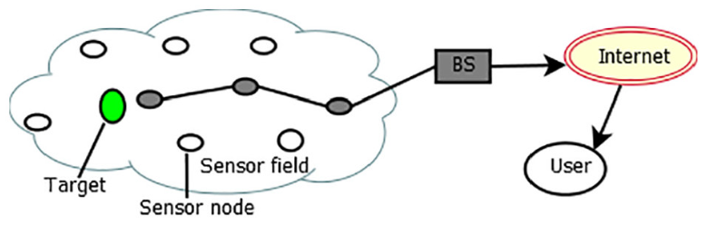
Industrial IoT and Industry 4.0
Wireless Sensor Network (WSN)
Tektork Private Limited, Coimbatore

Slide 193
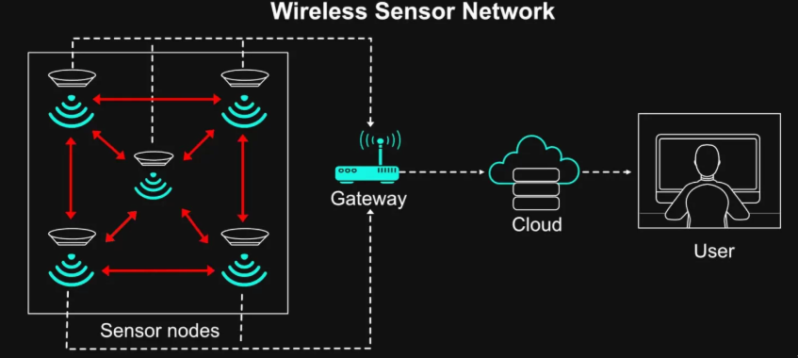
Industrial IoT and Industry 4.0
Wireless Sensor Network (WSN)
Tektork Private Limited, Coimbatore

Slide 194
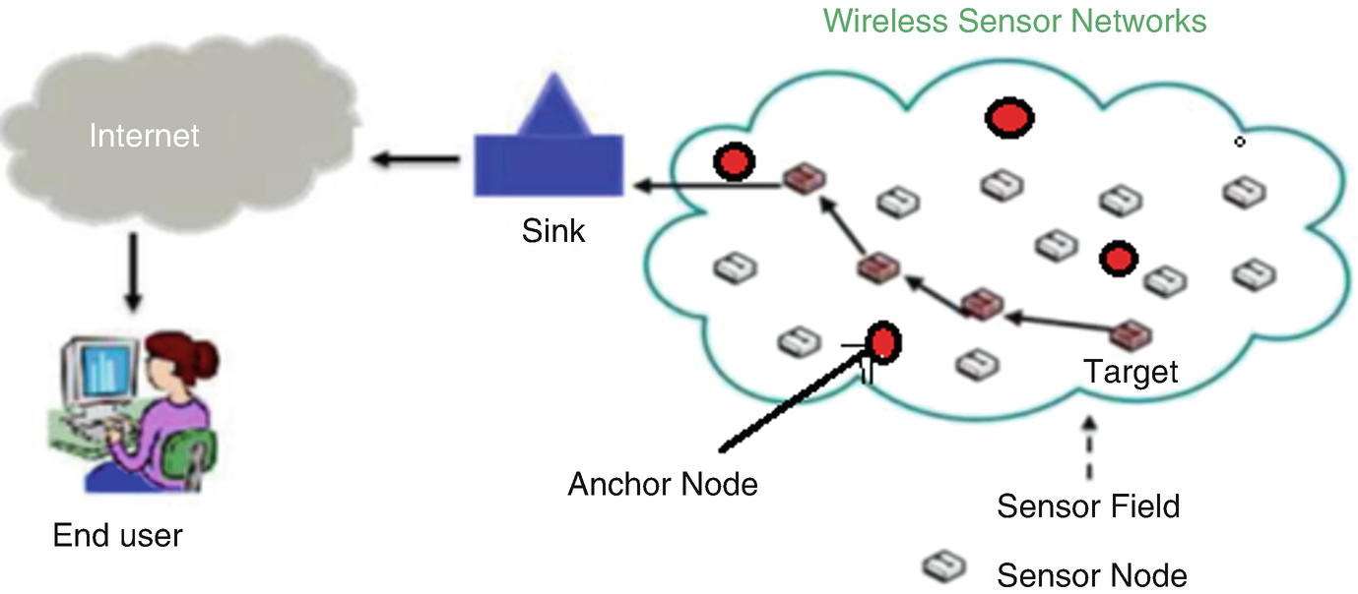
Industrial IoT and Industry 4.0
Wireless Sensor Network (WSN)
Tektork Private Limited, Coimbatore

Slide 195
Industrial IoT and Industry 4.0
Components of a WSN
The key components of a Wireless Sensor Network (WSN) include several integral parts, each serving a specific role to ensure efficient sensing, data transmission, and processing:
Sensor Nodes:
Small, low-power devices equipped with sensors that measure physical phenomena like temperature, light, pressure, humidity, or motion.
Each node contains a microcontroller to locally process and store collected data.
A transceiver module (e.g., Wi-Fi, Bluetooth, Zigbee) enables wireless communication between nodes and with other parts of the network.
Powered by batteries, often extended by energy harvesting methods such as solar panels to prolong network lifetime.
Tektork Private Limited, Coimbatore

Slide 196
Industrial IoT and Industry 4.0
Components of a WSN Cond..
Communication Layer:
Facilitates wireless data transmission within the network using protocols such as radio waves, ZigBee, Wi-Fi, or Bluetooth.
Ensures reliable and efficient communication between sensor nodes and the gateway or base station.
Gateways/Base Stations:
Serve as a bridge between the WSN and external networks like the internet.
Collect data from sensor nodes, aggregate, and forward it to central servers or user platforms for further analysis and storage.
Tektork Private Limited, Coimbatore

Slide 197
Industrial IoT and Industry 4.0
Components of a WSN Cond..
.
Middleware and Software:
Software layers handle data aggregation, processing, and interpretation, converting raw sensor input into meaningful information for users and applications.
Actuators (Optional):
Devices that perform actions based on sensor data, enabling bi-directional communication and control.
Example: In a smart irrigation system, an actuator might turn on sprinklers when soil moisture sensed by nodes falls below a threshold.
Tektork Private Limited, Coimbatore

Slide 198
Industrial IoT and Industry 4.0
Components of a WSN Cond..
.
Central Server/User Platform:
Centralized location, either local or cloud-based, that aggregates, processes, stores, and analyzes data collected through the WSN.
Provides interfaces for monitoring, visualization, and control for end users or automated systems.
Together, these components form a comprehensive ecosystem that allows a Wireless Sensor Network to sense, communicate, control, and provide actionable insights for various applications
Tektork Private Limited, Coimbatore

Slide 199
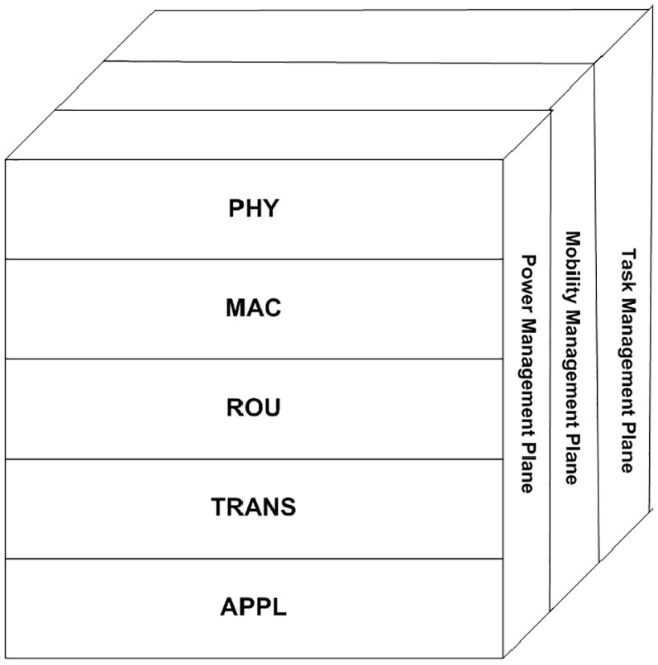
Industrial IoT and Industry 4.0
WSN Architecture Layers:
Tektork Private Limited, Coimbatore

Slide 200
Industrial IoT and Industry 4.0
WSN Architecture Layers:
Physical Layer: Deals with wireless communication hardware, radio transmission, and sensor connectivity.
Data Link Layer: Ensures reliable data transfer between nodes and handles MAC protocols to manage access to the communication medium.
Network Layer: Responsible for routing and forwarding packets efficiently from sensor nodes to the base station.
Transport Layer: Ensures end-to-end reliability, data integrity, and communication management.
Application Layer: Interfaces with users and processes sensor data according to application needs.
Tektork Private Limited, Coimbatore

Slide 201
Industrial IoT and Industry 4.0
Communication Protocols
Zigbee (IEEE 802.15.4) – low power, short range.
Bluetooth Low Energy (BLE) – wearable & mobile sensors.
LoRa/LoRaWAN – long range, low power.
Wi-Fi – higher data rate but power-hungry.
6LoWPAN – IPv6 over low-power wireless networks.
Tektork Private Limited, Coimbatore

Slide 202
Industrial IoT and Industry 4.0
Network Topologies in WSN:
Bus Topology: Nodes share a common communication line.
Star Topology: All nodes connect to a central master node.
Tree Topology: Nodes arranged hierarchically.
Mesh Topology: Nodes connect with multiple other nodes, providing redundancy and robustness.
Tektork Private Limited, Coimbatore

Slide 203
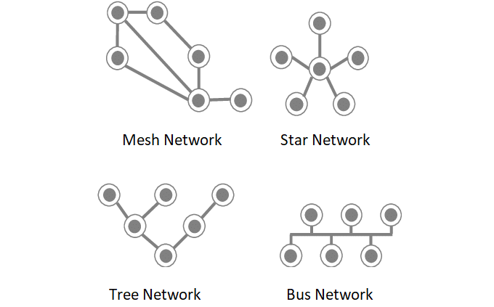
Industrial IoT and Industry 4.0
Network Topologies in WSN:
Tektork Private Limited, Coimbatore

Slide 204
Industrial IoT and Industry 4.0
Advantages of WSN
Cost-effective due to low-cost sensors.
Wireless and easy to deploy.
Energy-efficient for long-term operation.
Scalable and flexible.
Enables real-time monitoring of environments.
Tektork Private Limited, Coimbatore

Slide 205
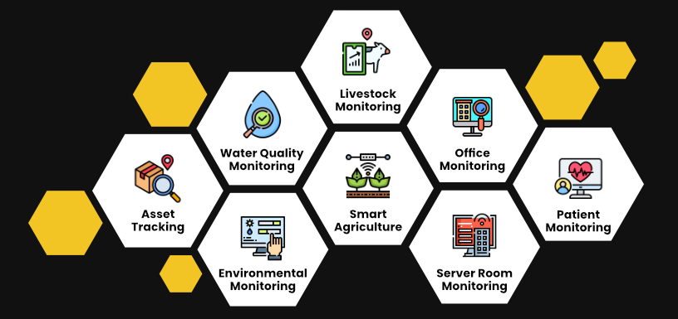
Industrial IoT and Industry 4.0
WSN Applications
Tektork Private Limited, Coimbatore

Slide 206
Industrial IoT and Industry 4.0
WSN Applications
WSNs have a wide range of applications across various industries:
Environmental Monitoring
Detecting and tracking forest fires, monitoring air and water quality, and surveying wildlife habitats.
Agriculture
Monitoring soil moisture, temperature, and humidity to optimize irrigation and crop yield.
Industrial Automation
Machine health monitoring, predictive maintenance, and control of industrial processes.
Tektork Private Limited, Coimbatore

Slide 207
Industrial IoT and Industry 4.0
WSN Applications Cond..
Healthcare
Remote patient monitoring, tracking the movement of patients and medical staff, and managing hospital assets.
Smart Cities
Managing traffic, monitoring structural health of bridges and buildings, and optimizing energy consumption in public spaces.
Military:
Battlefield surveillance, equipment tracking, and detection of chemical or biological threats.
Tektork Private Limited, Coimbatore

Slide 208
Industrial IoT and Industry 4.0
Challenges in WSN
Despite their utility, WSNs face several significant challenges:
Energy Efficiency
Most sensor nodes are battery-powered and operate in remote locations, making battery replacement difficult or impossible.
Minimizing power consumption through efficient communication protocols and sleep modes is crucial.
Scalability
A WSN may consist of hundreds or even thousands of nodes.
Designing the network to handle this scale and ensure reliable data routing is a complex task.
Tektork Private Limited, Coimbatore

Slide 209
Industrial IoT and Industry 4.0
Challenges in WSN Cond..
Security
Since communication is wireless, WSNs are vulnerable to various security threats, including data interception, node capture, and denial-of-service attacks.
Ensuring data confidentiality and integrity is a major concern.
Reliability and Fault Tolerance
Sensor nodes can fail due to harsh environmental conditions or power depletion.
The network must be able to tolerate these failures and maintain its functionality.
Data Management
The sheer volume of data generated by a large WSN requires efficient data aggregation, processing, and storage techniques to avoid overwhelming the network and its central server.
Tektork Private Limited, Coimbatore

Slide 210
Industrial IoT and Industry 4.0
Communication protocols
Communication protocols are sets of rules that allow two or more electronic devices to exchange data.
In embedded systems, three of the most common serial communication protocols are I²C, SPI, and UART.
Each has unique characteristics that make it suitable for different applications.
Tektork Private Limited, Coimbatore

Slide 211
Industrial IoT and Industry 4.0
I2C (Inter-Integrated Circuit)
I2C is a synchronous, multi-master, multi-slave serial communication protocol developed by Philips.
It uses only two wires: one for clock (SCL) and one for data (SDA).
Devices are assigned a unique 7-bit or 10-bit address, allowing a single master to communicate with multiple slaves on the same bus.
I2C is great for short-distance communication between components on a single circuit board, like communicating with EEPROMs, real-time clocks, and sensors.
Tektork Private Limited, Coimbatore

Slide 212
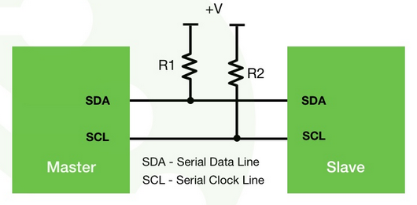
Industrial IoT and Industry 4.0
I2C (Inter-Integrated Circuit)
Tektork Private Limited, Coimbatore

Slide 213
Industrial IoT and Industry 4.0
I2C (Inter-Integrated Circuit)
Key Features
Two-wire interface:
This is a major advantage, as it simplifies hardware and reduces the number of pins required on microcontrollers.
Half-duplex communication:
Data can be sent and received on the same line, but not at the same time.
Multi-master/multi-slave support:
Multiple master and multiple slave devices can be connected on the same bus.
Tektork Private Limited, Coimbatore

Slide 214
Industrial IoT and Industry 4.0
I2C (Inter-Integrated Circuit)
Key Features
Addressing:
The address-based system allows the master to communicate with multiple slaves individually.
Open-drain:
Both the SDA and SCL lines are "open-drain," requiring pull-up resistors to maintain a high logic state when no device is pulling them low.
This design prevents conflicts if multiple devices try to drive the bus at the same time.
Tektork Private Limited, Coimbatore

Slide 215
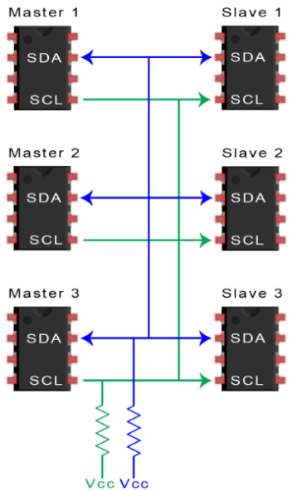
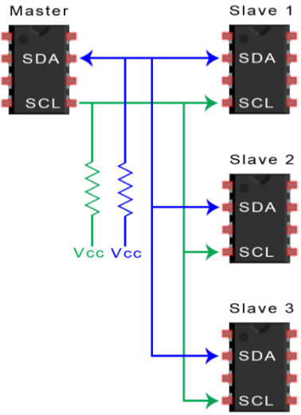
Industrial IoT and Industry 4.0
Tektork Private Limited, Coimbatore

Slide 216

Industrial IoT and Industry 4.0
Tektork Private Limited, Coimbatore

Slide 217

Industrial IoT and Industry 4.0
Tektork Private Limited, Coimbatore

Slide 218
Industrial IoT and Industry 4.0
Communication process
Start condition: The master device initiates communication by pulling the SDA line low while the SCL line is high.
Addressing: The master sends the 7-bit or 10-bit address of the target slave device, followed by a read/write bit to indicate the direction of data transfer.
Acknowledge (ACK): The addressed slave device pulls the SDA line low to acknowledge that it has received its address. If the slave doesn't acknowledge, the master can generate a stop condition.
Data transfer: The master or slave (depending on the read/write bit) transfers 8 bits of data. After each byte, the receiving device must send an acknowledge bit.
Stop condition: The master ends the communication by pulling the SDA line high while the SCL line is high.
Tektork Private Limited, Coimbatore

Slide 219
Industrial IoT and Industry 4.0
Characteristics
Multi-master support: Multiple masters can exist on the same bus, but only one can control the bus at a time. A process called "arbitration" handles conflicts if two masters try to communicate at the same time.
Simple wiring: Only two wires are needed for communication, which simplifies circuit design.
Cost-effective: The protocol is simple and requires minimal hardware, making it a low-cost solution.
Moderate speed: It's faster than protocols like UART but slower than SPI. Standard speeds include 100 kbps (Standard Mode), 400 kbps (Fast Mode), and 1 Mbps (Fast-mode Plus).
Addressing: Each device has a unique address, allowing multiple devices to share the same bus.
Tektork Private Limited, Coimbatore

Slide 220
Industrial IoT and Industry 4.0
I²C Speed Modes
Mode | Speed
Standard | 100 kbps
Fast | 400 kbps
Fast Plus | 1 Mbps
High Speed | 3.4 Mbps
Ultra Fast | 5 Mbps (rare)
Tektork Private Limited, Coimbatore

Slide 221
Industrial IoT and Industry 4.0
I2C Protocol
Advantages
It supports various master devices.
It offers multi-slave and multi-master communication.
This protocol is flexible and adaptable too.
Disadvantages
I2C is a bit slower protocol because of the need for pull-up resistors.
It takes up more space.
The architecture is more complex with the increasing number of devices.
This protocol is half-duplex, which is quite problematic and requires different devices for complete communication.
Tektork Private Limited, Coimbatore

Slide 222
Industrial IoT and Industry 4.0
Tektork Private Limited, Coimbatore

Slide 223
Industrial IoT and Industry 4.0
SPI (Serial Peripheral Interface)
SPI is a synchronous, full-duplex serial communication protocol.
It's often used for short-distance communication, primarily in embedded systems.
It uses a master-slave architecture and requires four wires:
SCLK (Serial Clock): The clock signal generated by the master.
MOSI (Master Out, Slave In): Data from the master to the slave.
MISO (Master In, Slave Out): Data from the slave to the master.
SS (Slave Select) or CS (Chip Select): A signal used by the master to enable communication with a specific slave.
SPI is faster than I2C and is commonly used for communicating with flash memory, ADC (Analog-to-Digital Converters), DAC (Digital-to-Analog Converters), and SD card modules.
Tektork Private Limited, Coimbatore

Slide 224
Industrial IoT and Industry 4.0
SPI (Serial Peripheral Interface)
Key Features
Four-wire interface: SCLK, MOSI, MISO, and SS.
Synchronous: Uses a shared clock signal.
Full-duplex: Data can be sent and received simultaneously.
Single-master, multiple-slaves: One master communicates with one or more slaves (one at a time using the SS line).
High speed: Can operate at very high speeds, often in the tens of MHz.
No acknowledgment: There is no built-in acknowledgment mechanism.
Tektork Private Limited, Coimbatore

Slide 225

Industrial IoT and Industry 4.0
SPI (Serial Peripheral Interface)
Tektork Private Limited, Coimbatore

Slide 226

Industrial IoT and Industry 4.0
Tektork Private Limited, Coimbatore

Slide 227
Industrial IoT and Industry 4.0
Communication process
The master device pulls the SS line for the desired slave low to select it.
The master generates the clock signal on the SCLK line.
Simultaneously, the master sends data on the MOSI line, and the selected slave sends data back on the MISO line. This is the full-duplex nature of SPI, as data can be sent and received at the same time.
Data is transferred bit by bit, synchronized with the SCLK.
After the transfer is complete, the master pulls the SS line high to deselect the slave.
Tektork Private Limited, Coimbatore

Slide 228
Industrial IoT and Industry 4.0
Characteristics
High Speed: SPI is significantly faster than protocols like I²C because it doesn't have the overhead of addressing and acknowledgments. It can reach speeds in the tens of MHz.
Full-Duplex: Data can be sent and received at the same time, increasing throughput.
Simple: The protocol is very simple with no complex addressing or arbitration logic.
Single Master: The bus can only have one master, though it can communicate with multiple slaves.
More Wires: A major drawback is the need for a dedicated Slave Select line for each slave, which increases the number of required wires as more devices are added.
Tektork Private Limited, Coimbatore

Slide 229
Industrial IoT and Industry 4.0
SPI Protocol Operating Modes
The SPI protocol can operate in various modes, including:
Mode 0: In Mode 0, the clock signal is low when idle, and data is sampled on the rising edge of the clock signal.
Mode 1: In Mode 1, the clock signal is low when idle, and data is sampled on the falling edge of the clock signal.
Mode 2: In Mode 2, the clock signal is high when idle, and data is sampled on the falling edge of the clock signal.
Mode 3: In Mode 3, the clock signal is high when idle, and data is sampled on the rising edge of the clock signal.
Tektork Private Limited, Coimbatore

Slide 230
Industrial IoT and Industry 4.0
SPI Protocol
Advantages
Supports full duplex communication.
Simple and fast data transmission rate.
Offers simple software implications.
No, start and stop bits allow continuous data transmission with no interruptions.
MOSI and MISO allow simultaneous data send and receive operations.
The use of a master clock doesn't require precious oscillators.
Tektork Private Limited, Coimbatore

Slide 231
Industrial IoT and Industry 4.0
SPI Protocol
Disadvantages
More use of slave devices complicates the wiring.
It has a single master device.
Limits the number of slave's devices to connect with the Master.
No error check mechanism.
Don't have an acknowledgment line of data receiving a message.
Tektork Private Limited, Coimbatore

Slide 232
Industrial IoT and Industry 4.0
UART (Universal Asynchronous Receiver/Transmitter)
UART is an asynchronous communication protocol, meaning it doesn't use a clock signal to synchronize the sender and receiver. Instead, it relies on both devices having a pre-agreed baud rate (the rate at which data is transmitted).
It's a point-to-point protocol, meaning it's primarily used for communication between two devices.
It uses two wires:
TX (Transmitter): The line used for sending data.
RX (Receiver): The line used for receiving data.
UART is widely used for communication between a microcontroller and a computer (via a USB-to-serial converter), GPS modules, Bluetooth modules, and other peripherals.
Tektork Private Limited, Coimbatore

Slide 233

Industrial IoT and Industry 4.0
UART (Universal Asynchronous Receiver/Transmitter)
Tektork Private Limited, Coimbatore

Slide 234
Industrial IoT and Industry 4.0
UART works in three various ways
Simplex: In a simplex system, data is transmitted in only one direction.
Half-duplex: In a half-duplex system, data is transmitted in both directions but not simultaneously.
Full-duplex: In a full-duplex system, data is simultaneously transmitted in both directions.
Tektork Private Limited, Coimbatore

Slide 235
Industrial IoT and Industry 4.0
Communication process
The data is sent in packets or frames, which consist of:
Start Bit: A single bit that signals the beginning of a new data frame. It is a transition from a high voltage level to a low voltage level.
Data Bits: The actual data being transmitted, typically 5 to 9 bits long. The least significant bit (LSB) is usually sent first.
Parity Bit (Optional): An optional bit used for error checking. It helps the receiver detect if a single bit has been corrupted during transmission.
Stop Bit(s): One or two bits that signal the end of the data frame. They are a transition back to a high voltage level.
Tektork Private Limited, Coimbatore

Slide 236
Industrial IoT and Industry 4.0
Characteristics
Asynchronous: No clock signal is needed, which simplifies the wiring. However, both devices must agree on the same baud rate.
Full-Duplex: UART allows for simultaneous two-way communication since it has separate transmit and receive lines.
Simple: The protocol is straightforward to implement and requires minimal hardware overhead.
Limited: UART is generally used for point-to-point communication between two devices and is not suitable for multi-master or multi-slave configurations like I²C or SPI. Its speed is also much lower than SPI.
Tektork Private Limited, Coimbatore

Slide 237
Industrial IoT and Industry 4.0
UART (Universal Asynchronous Receiver/Transmitter)
Key Features
Two-wire interface: TX and RX.
Asynchronous: No shared clock signal.
Half-duplex: Data is sent in one direction at a time (unless both devices can transmit and receive simultaneously).
Point-to-point: Typically used for one-to-one communication.
Variable speed: The baud rate must be set identically on both the transmitter and receiver.
Data framing: Each byte of data is framed with a start bit and a stop bit for synchronization.
Tektork Private Limited, Coimbatore

Slide 238
Industrial IoT and Industry 4.0
UART Protocols
Advantages
It only uses two lines or wires helping to clean circuitry
It doesn't require a clock signal.
It has a parity bit for error checking.
It is an easy and widely used method of communication.
Disadvantages
It has a limited data size of 9 bits only.
It doesn't support multiple Master and slave devices.
The baud rate or the data transmission speed should be below 10 % or each other.
The data transmission rate is lower compared to the remaining protocols.
Tektork Private Limited, Coimbatore

Slide 239
Industrial IoT and Industry 4.0
Features | UART | SPI | I2C
Full Form | Universal Asynchronous Receiver/Transmitter | Serial Peripheral Interface | Inter-Integrated Circuit
Pin Designations | TxD: Transmit Data RxD: Receive Data | SCLK: Serial Clock MOSI: Master Output, Slave Input MISO: Master Input, Slave Output SS: Slave Select | SDA: Serial Data SCL: Serial Clock
Data rate | The maximum data rate supported is about 230 Kbps to 460 Kbps. | Usually supports about 10 Mbps to 20 Mbps | I2C supports 100 kbps, 400 kbps, and 3.4 Mbps. Some variants also support 10 Kbps and 1 Mbps.
Type of communication interfaces | Asynchronous | Synchronous | Synchronous
Distance | Lower about 50 feet | highest | Higher
Master Device | One | One | One or more than One
Clock | No use of Common Clock signal. Both devices will use their independent clocks. | There is one common serial clock signal between master and slave devices. | There is a common clock signal between multiple masters and multiple slaves.
Tektork Private Limited, Coimbatore

Slide 240
Industrial IoT and Industry 4.0
Features | UART | SPI | I2C
Hardware complexity | lesser | less | more
Protocol | For 8 bits of data, one start bit and one stop bit are used. | Each manufacturer has got their own specific protocols to communicate with peripherals. Hence, a datasheet is a must-to-know read/write the protocol for SPI communication to be established. | It uses start and stops bits. It uses an ACK bit for every 8 bits of data which indicates whether data has been received or not.
Software addressing | There is no need for addressing since this is a one-to-one connection between two devices. | Any slave connected with the master is addressed by a slave select line. A master device will have 'n' slave select lines for 'n' slaves. | Any slave connected with the master is addressed by a slave select line. A master device will have 'n' slave select lines for 'n' slaves.
Tektork Private Limited, Coimbatore

Slide 241
Industrial IoT and Industry 4.0
Thank You
Tektork Private Limited, Coimbatore

